Slide 1
Designing Tough Carbon Nanotube Fibers
LAMMPS User’s Workshop
August 9–11, 2011
Sandia National Laboratories
Albuquerque, NM
DISTRIBUTION STATEMENT A Approved for public release; distribution is unlimited
Charles F. Cornwell
US Army Engineer Research and Development Center
3909 Halls Ferry Road
Vicksburg, MS 39180
Notes:
Thank Organizers

Slide 2

Designing Tough Carbon Nanotube Fibers
Materials Research from Nanoscale to Macroscale
Dr. Charles Cornwell
Leader
Atomistic Simulation Team
Information Technology Laboratory,
US Army Engineer Research and Development Center
Vicksburg, MS
Notes:
Project part of larger program – Atomistic and molecular design simulations support:
Atomistic
Synthesis
Advanced structural concepts

Slide 3
Advanced Materials Initiative - Research Team
ERDC Researchers: Dr. Bob Ebeling (Team Lead-Structural Concepts),
Dr. Charles Marsh (Team Lead-Material Synthesis), Dr. Charles Cornwell (Team Lead – Atomistic Modeling), Dr. Mei Chandler, Toney Cummins, Dr. Paul Allison, Clint Arnett, Dr. N. Jabari Lee, Dr. James Baylot,
Dr. Bryce Devine, Dr. Fran Hill, Thomas Carlson, Dr. Kevin Abraham, Pete Stynoski, Thomas Hymal, Jonathan George, Ben Ulmen, Dr. Meredith C.K. Sellers, Kyle Ford, Erik Wotring, Dr. Jeff Allen, Dr. Laura Walizer
Natick Collaborators: Claudia Quigley, Karen Buehler, Dr. Mike Sennett
NASA Collaborators: Dr. Richard Jaffe (NASA Ames), Dr. Mike Meador (NASA Glenn)
Rice U. Collaborators: Prof. Matteo Pasquali, Nobel Laureate Prof. Robert Curl, Prof. Robert Hauge
DTRA Collaborators: Dr. Jeffrey DePriest, Dr. Heather Meeks
MIT/ISN Collaborators: Prof. Mike Strano, Prof. Markus Buehler
U. of Illinois/Champaign Collaborators: Prof. Parimita Mondal, Prof. Waltrude Kriven, Prof. Alexi Bezryadin
ARL Collaborators: Dr. Daphne Papas, Dr. Michelle Fleischman
ARO MURI Team Collaborators: Dr. David Stepp, Dr. Doug Kiserow, Northwestern U., others
Imperial College/Queen Mary College: Prof. Eduardo Saiz, Prof. Mike Reece (funded/coordinated through Army International Research Office, Dr. Steve Grant)
DoD HPCMO PETTT-funded Collaborators: Prof. Susan Sinnott (U. FL); Prof. Steve Stuart (Clemson U.); Prof. Anthony Rollett (Carnegie Mellon U.)
Program Managers – Dr. Bob Welch and Dr. John Peters
Notes:
Contributors for program
Contributors that support atomistic simulations

Slide 4
Overview
Motivation
CNT Fibers
CNT Fibers with Cross-links
CNT Fiber Post-yield
Current Work (Ceramics)
Notes:
Presentation will cove the atomistic simulations but will also emphasize interactions with other components of program and collaborators in academia and industry

Slide 5
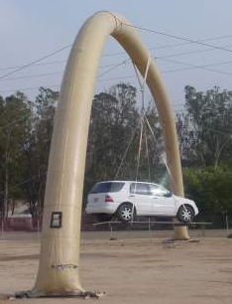
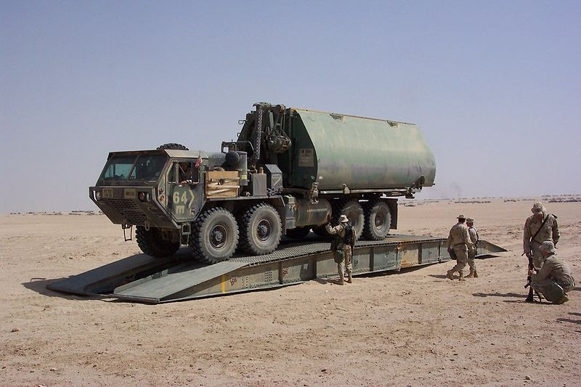
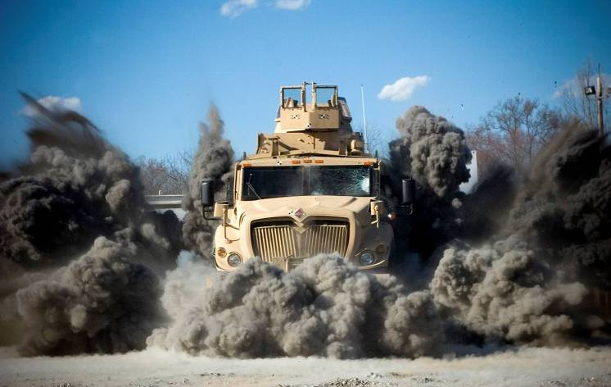
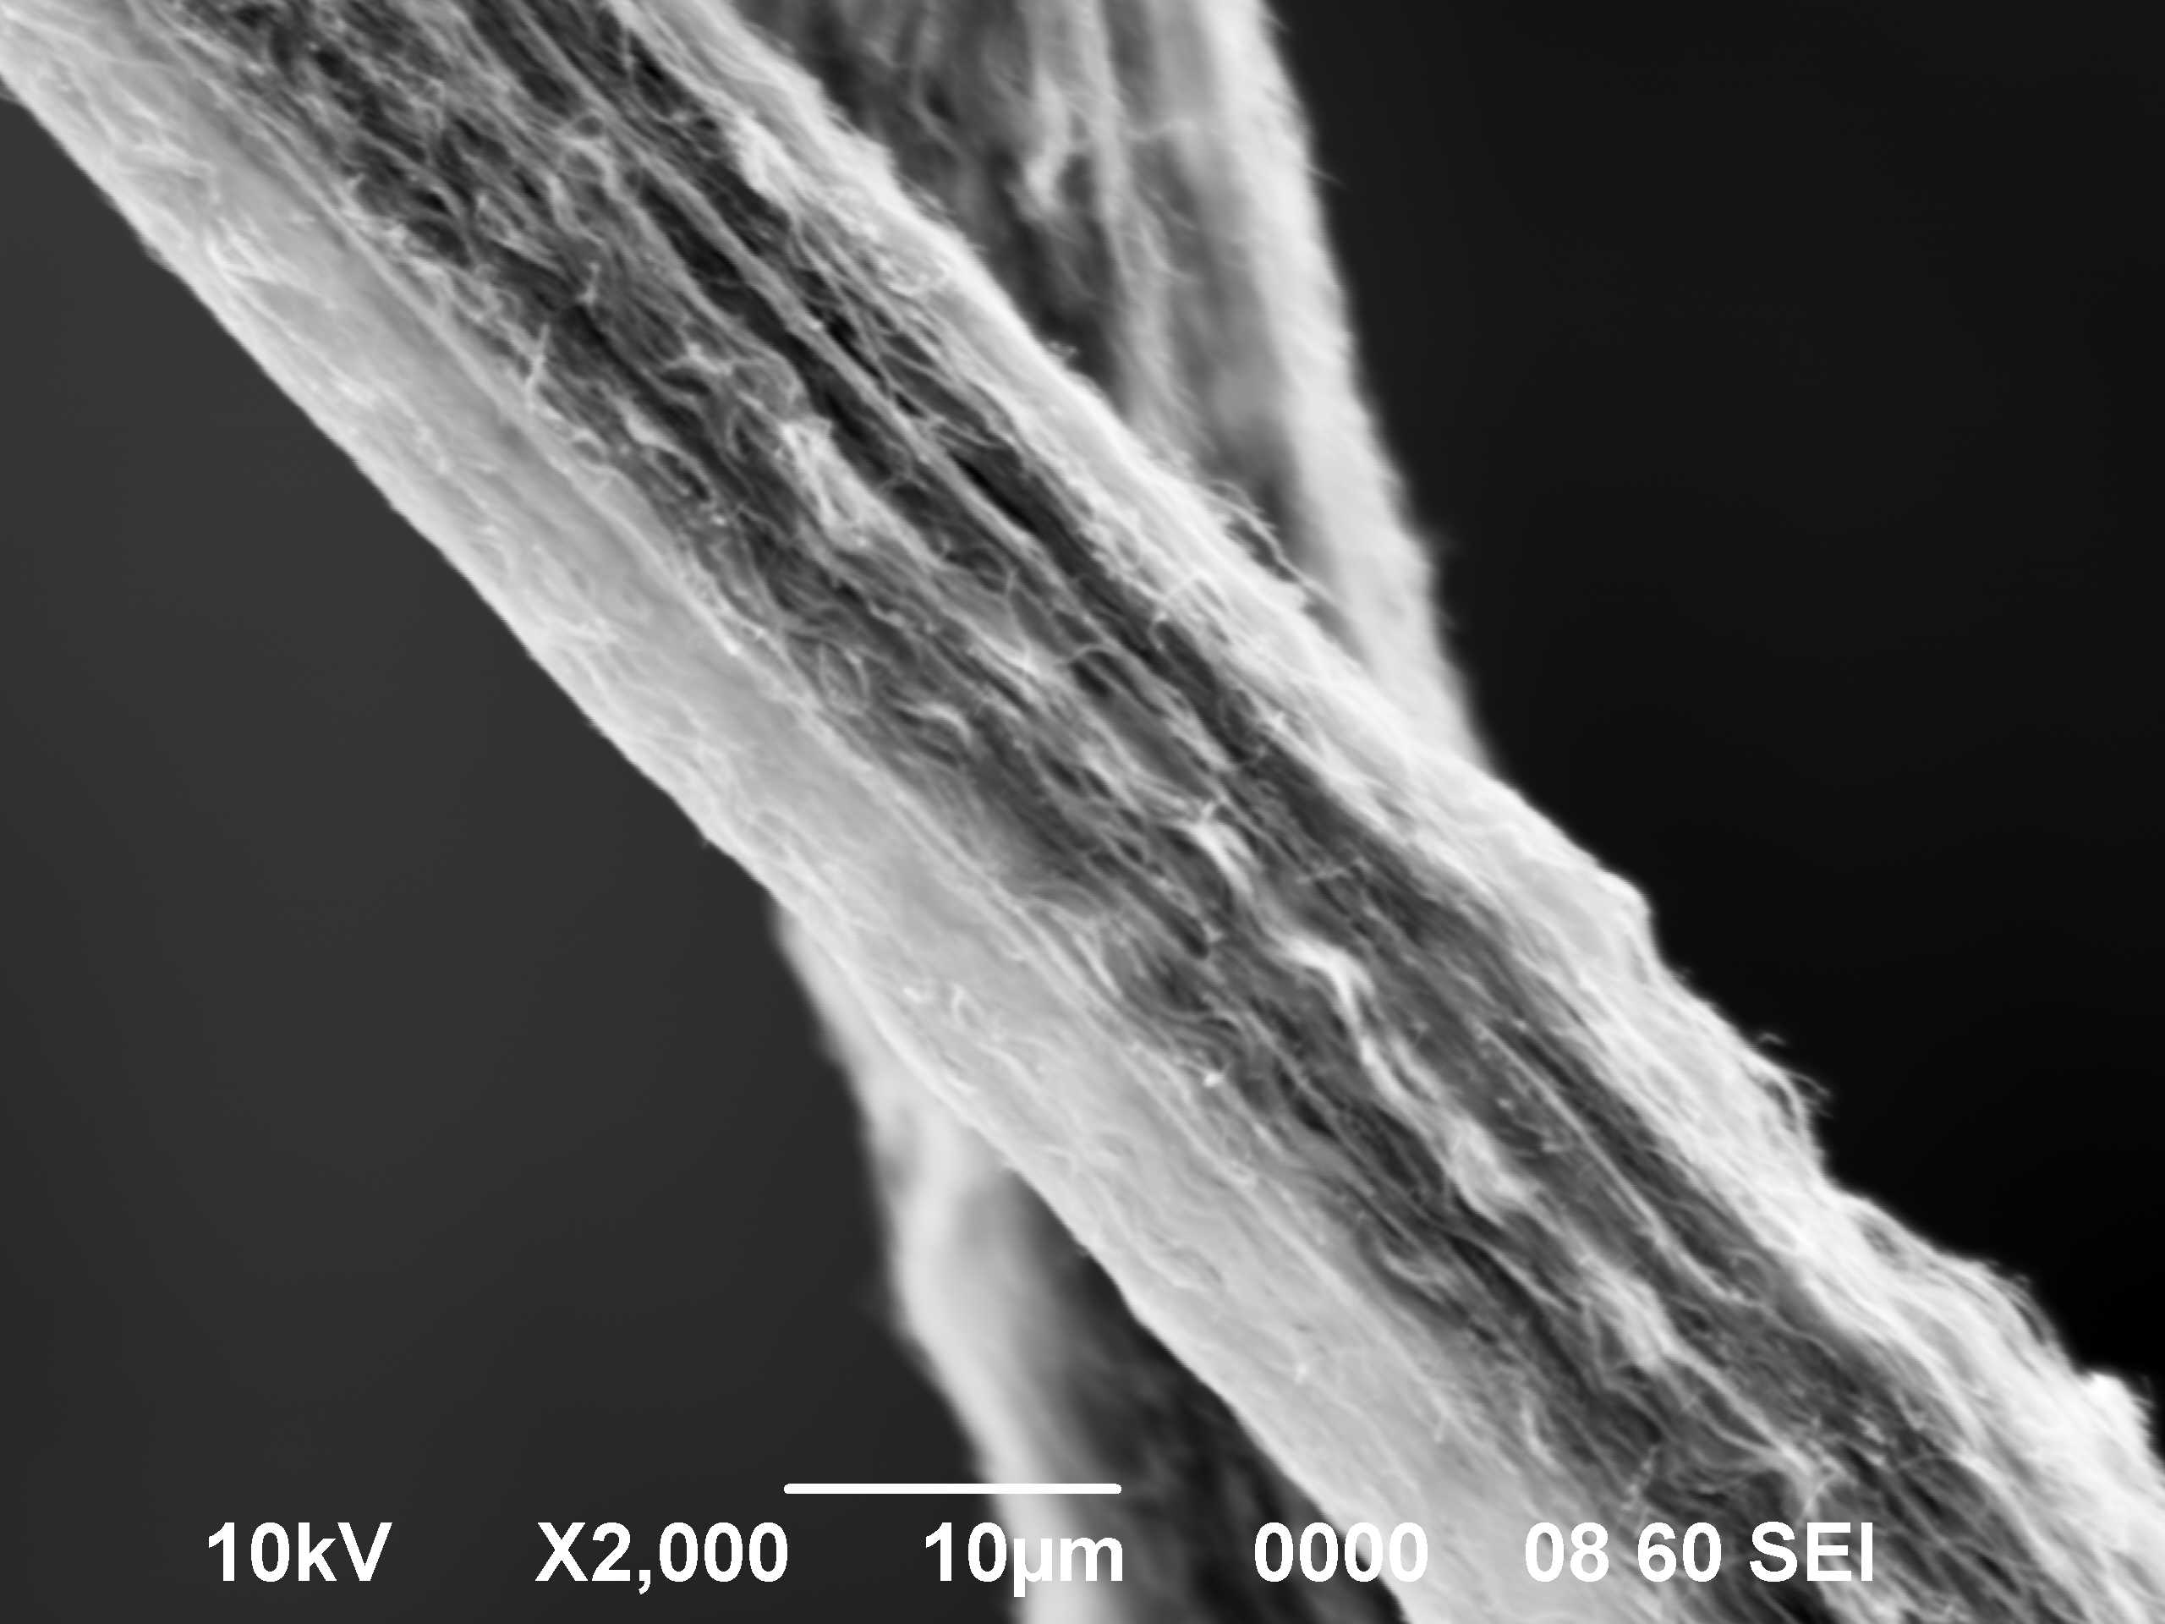
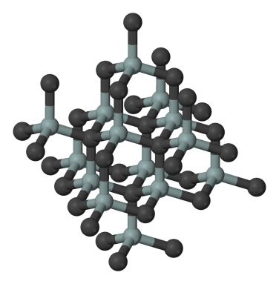
Military and Civil Engineering are
dependent on 3 areas:
Newtonian (Classical) Mechanics – static.
Policies and procedures – slowly changing.
Materials – potential orders-of-magnitude improvement.
  Requires taking advantage of nanoscale material properties.
  Requires building to molecular design.
Materials underpin almost all technology…. Portions of human history are named for the predominant materials of the day.
Notes:
5
Materials is where major advances in military and civil engineering

Slide 6
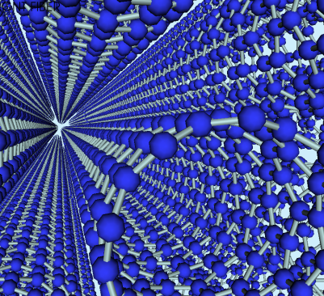
Initial Super Materials Program
Carbon Nanotube-Based Filaments, Membranes, Coatings
Molecular dynamics simulation of a hexagonal closest-packed bundle of carbon nanotubes
Goal: Develop carbon nanotube (CNT)-based 1-million-psi tensile material (filaments, membranes) to Technology Readiness Level 4 (laboratory demo).
This would be a major accomplishment:
  Results in material with 2X strength/weight ratio of Kevlar and 5X tensile strength of very high strength steel (4340 alloy).
  Inaugurates a paradigm shift in material development.
  Lays the technical foundation for rapid development of other “super” materials and materials by design.
Notes:
Project goals: develop a lab sample of material with specific properties
Material must have potential impact on engineering applications
Connection with Advanced Structural Concepts

Slide 7
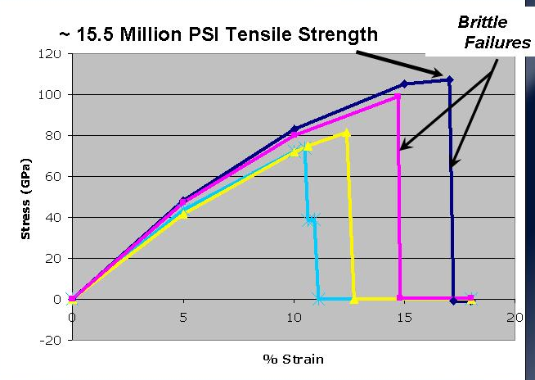
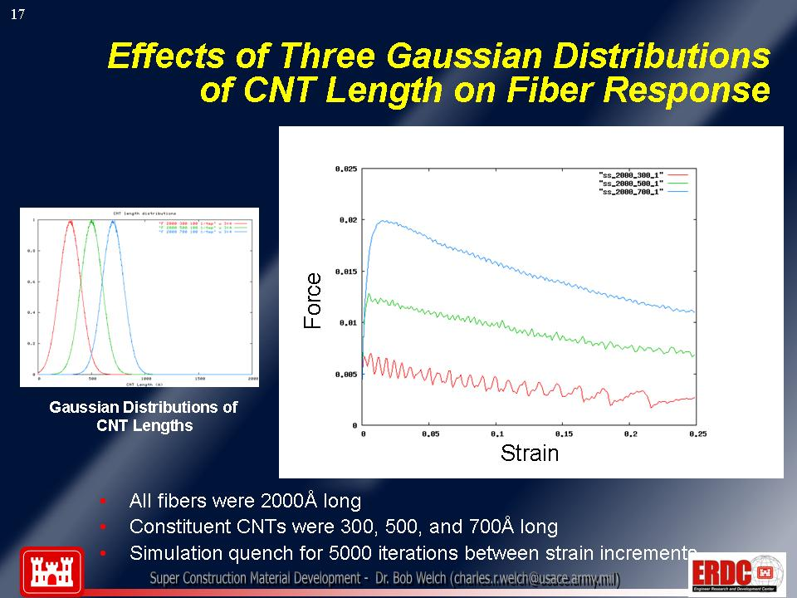
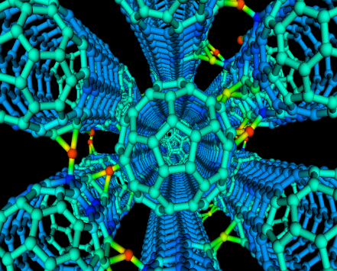
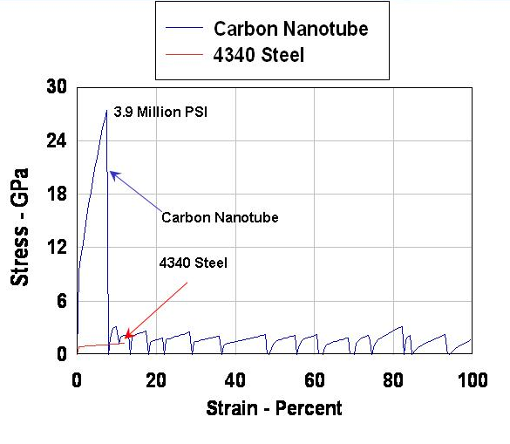
Some ERDC Scientific Contributions from
Molecular Dynamics Simulations
Defects and CNT tensile strength; brittle behavior of most CNTs (predicted Haskins et al., 2007; validated Peng et al., 2008)
MD Simulations Using Statistical Models of Molecular Constructs
(Cornwell et al., 2009)
Methods to overcome CNT brittle behavior by chirality and pre-twisting (Welch et al., 2006; Majure et al., submitted )
van der Waals forces are asymptotic
No critical length.
(Cornwell et al., 2008)
Notes:
Effect of defects on CNT strength
Designs to avoid Brittle behavior
Van der Waals force and CNT contact length (Dead end)

Slide 8

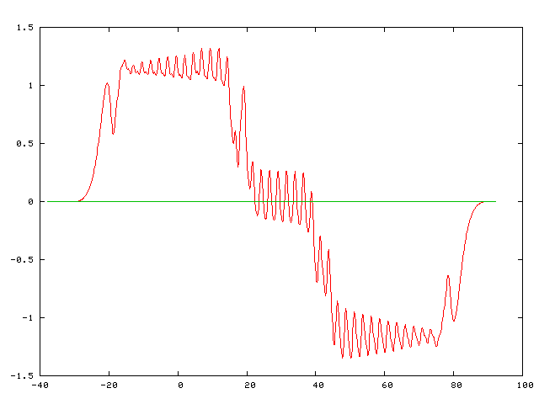
CNT-CNT Interaction, CNT Oscillator, Pullout Test
Test New Fiber Design
PULLOUT TEST
Net Force in Passing Tube Through Bundle (6,6) (Preliminary Results)
Insert below
Total Force (eV/A)
Time-Step (0.1 angstrom/step)
Force / distance
Increases
with Longer
Tubes (@ F/L)
Total Force
van der Waals force
Rings

Slide 9
Effects of Overlap Length on van der Waals Forces Between Molecules
NO CRITICAL LENGTH
For short overlap lengths, force is linear with length.
For large overlap lengths, molecular deformation results in “stick-slip” behavior that limits force.
There is no “critical length” for creep response.
Molecular dynamics analyses prevented us from going down a developmental dead end.
Peak pull-out force versus overlap length (rate effects neglected)
(Cornwell et al., July 2008)

Slide 10
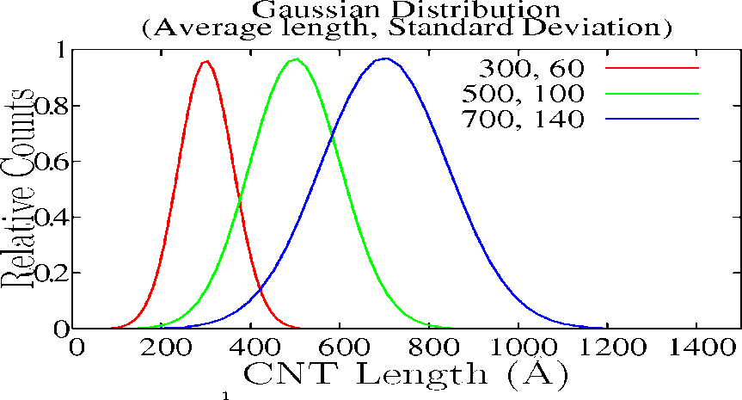
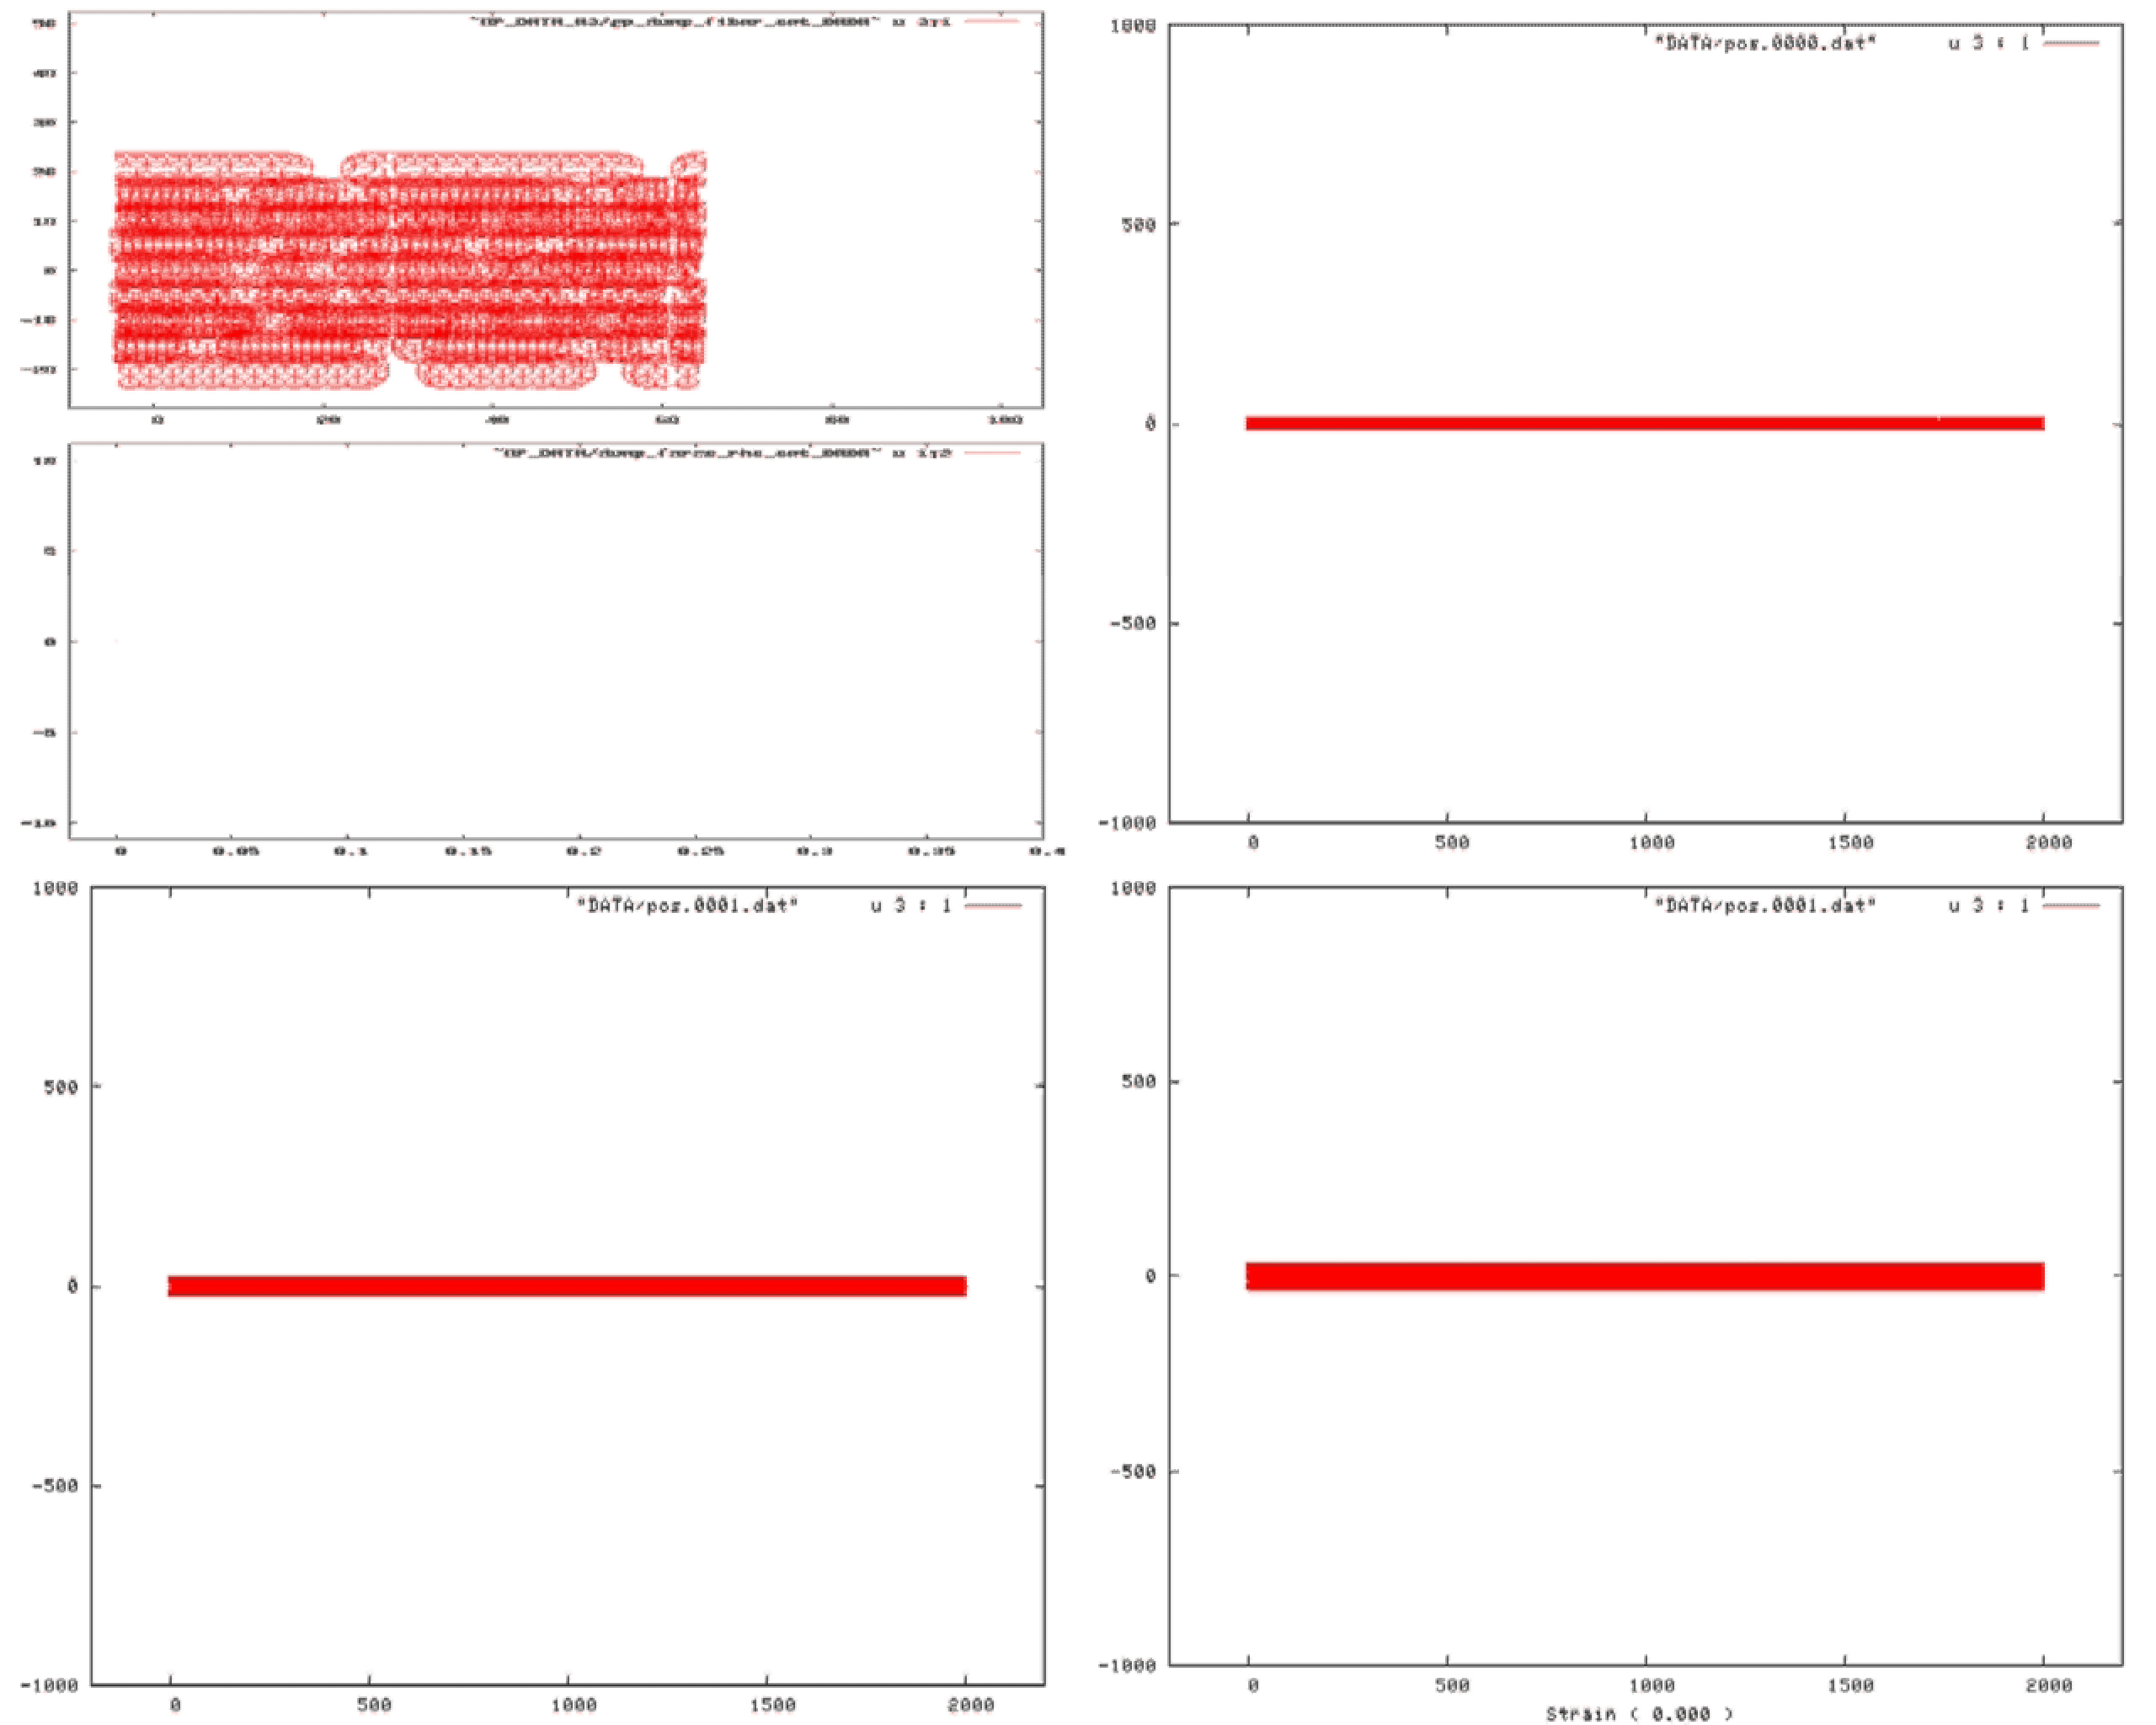
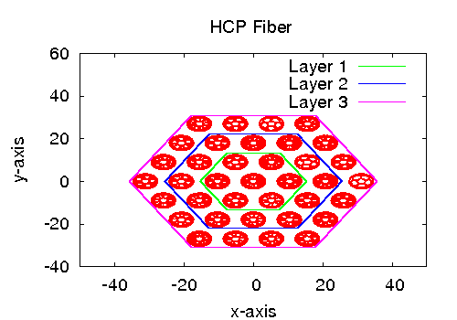
Effects of Three Gaussian Distributions
of CNT Length on Fiber Response
Gaussian Distributions of CNT Lengths
All fibers were 2000Å long and the average length of the CNT’s was 500Å.
The fibers had 1, 2, and 3 HCP rings.
Short fiber: force versus strain
(Cornwell et al., 2009)
Notes:
Fiber design – Gaussian distribution of CNT length and standard deviation
Fiber Cross-section

Slide 11
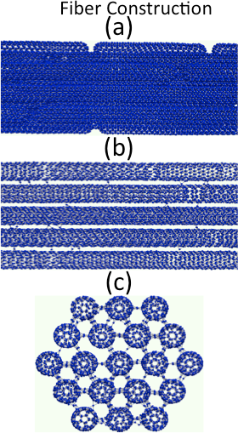
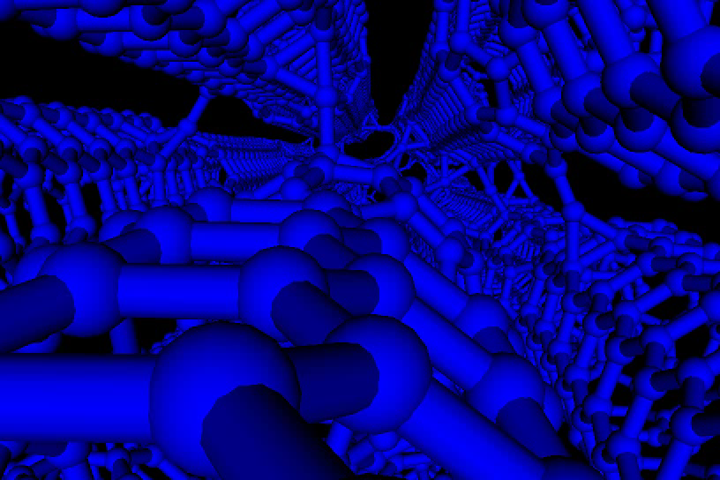
Fiber Cross-link Design
Carbon nanotube fiber (a) CNTs placed end-to-end along the length of the fiber; (b) cross-links placed along length of fiber; (c) cross section of fiber with cross-links between the strands of the fiber.
11
Notes:
Cross-link distribution along length
Cross-links break without damage to CNTs

Slide 12
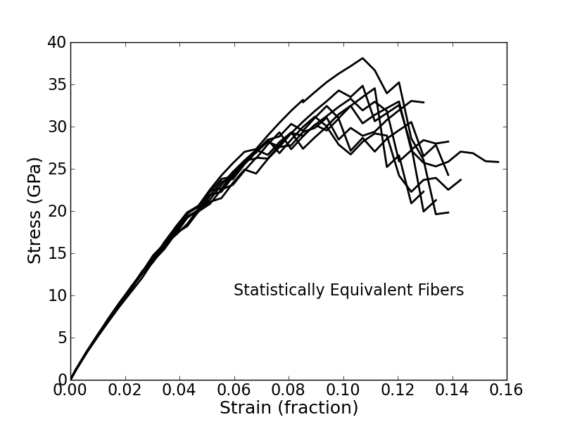
Statistically Equivalent Fibers
Fibers are constructed using carbon nanotubes with random orientations, random distribution of lengths, and a random distribution of cross-link atoms.
The average maximum stress for the eight simulations is 33.467 GPa with a standard deviation of 2.495 GPa. (7.46 % avg max stress)
The average elastic modulus of 586.434 GPa with a standard deviation of 14.743 Gpa.
(2.51 % avg modulus)
Stress-strain curves for eight statistically equivalent fibers. A different seed is used for the random number generator to construct the fiber. All of the fibers are 4000Å long and are constructed using carbon nanotubes with an average length of 1000Å with a standard deviation in the tube length of 200Å. They all had a cross-link concentration of about 0.225 percent .
Notes:
Consistent results with statistically equivalent fibers

Slide 13
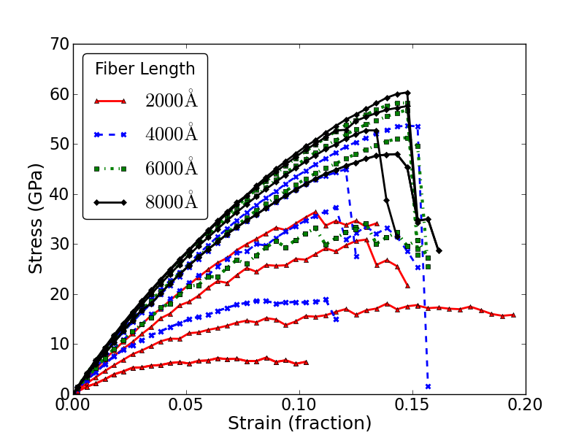
Multimillion PSI, Scalable CNT Fiber Design
(Cross-Linked Fibers)
~ 8.6 Million PSI
Goal - 1 Million PSI
Cross-link densities varied from 0.125 % to 0.75%
Journal of Chemical Physics, 134, pp. 204798, 2011.
Simulations predict optimum CNT length & cross-link density fiber will exceed design goal by 8 fold.
Simulations are first to quantify cross-linking strength effects on complete CNT fibers & identify van der Waals attraction as a dead-end design approach.
Simulations are first to identify a scalable molecular design for a many-million-psi fiber.
Experimental results of double-walled CNT bundles achieved a maximum effective tensile strength of 17.1 GPa. “T. Filleter, R. Bernal, S. Li, H.D. Espinosa, Adv. Mater. 2011, Apr 29”
Notes:
Ideal conditions: i.e. defect free CNTs and a uniform distribution of cross-links
Experimental results beginning to verify simulation rsults: CNT fiber and multi-walled CNTs

Slide 14
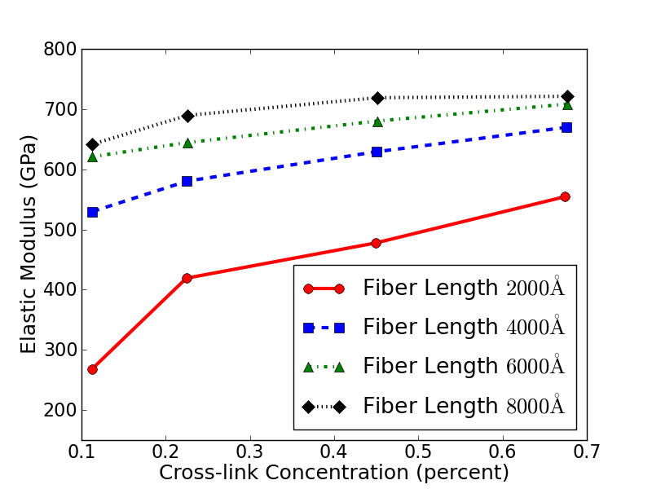
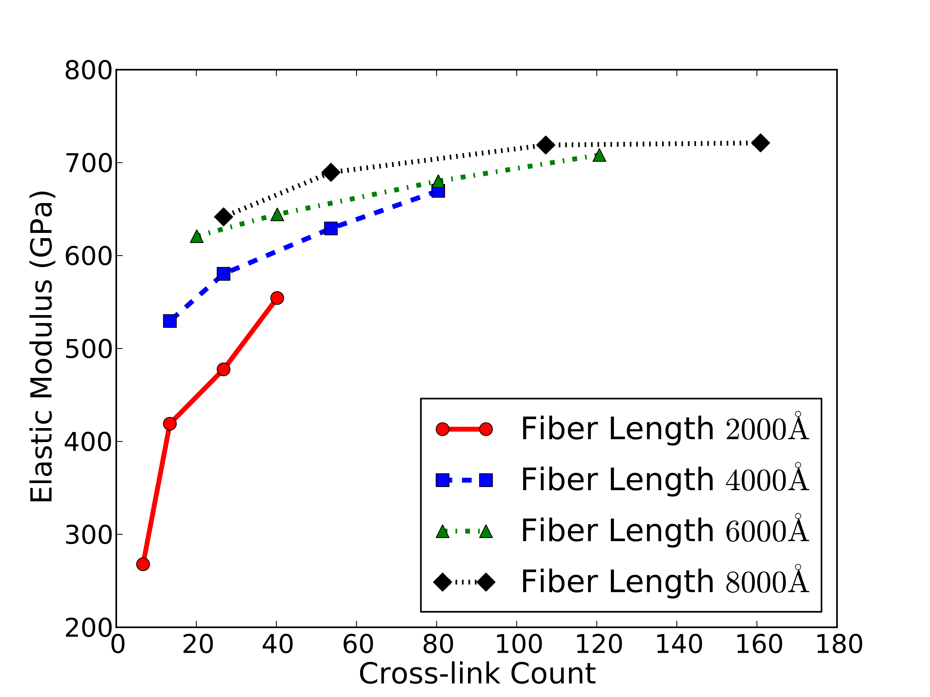
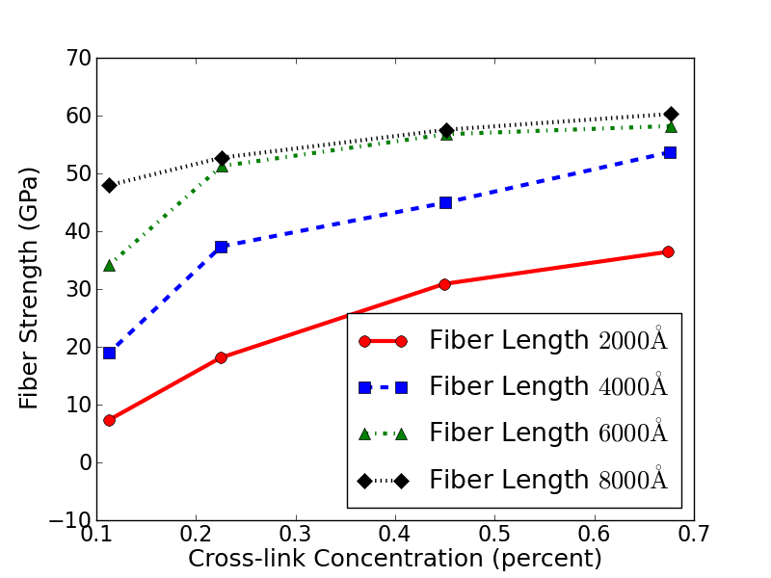
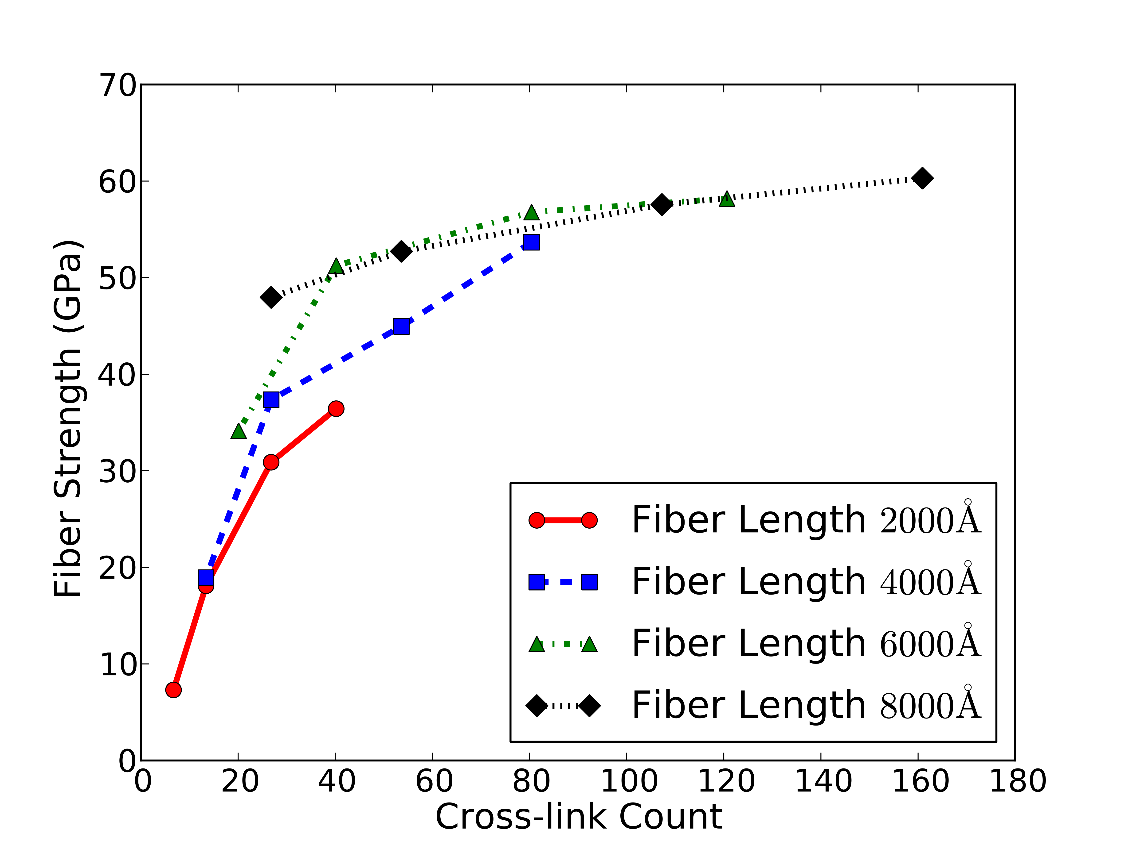
cross-link concentration (percent)
Cross-link Count
average number of cross-links of the core CNTs
Notes:
The number of cross-links per CNT is major factor controlling strength
Maximum strength with fewer cross-links using longer CNTs

Slide 15
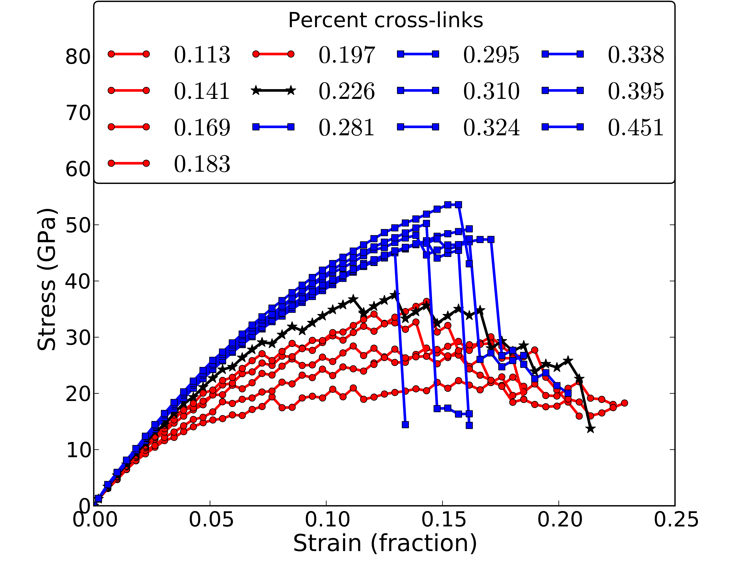
The minimum elastic modulus and tensile strength were 582.83 GPa and 22.88 GPa, respectively.
The maximum elastic modulus and tensile strength were 656.50 GPa and 53.58 GPa, respectively.
All of the bundles with cross-link concentrations less than or equal to 0.226 percent showed ductile behavior.
Bundles with cross-link concentrations greater than 0.226 percent showed brittle behavior.
Cross-link densities varied from 0.113 % to 0.451%
Notes:
Post-yield behavior
Brittle: Abrupt change in stress with increase in strain
Ductile: gradual change in stress with increase in strain

Slide 16
Time evolution of the stress and strain for two increments of increased strain
The strain was held constant for a period after each increase in strain to allow the stress to equilibrate.
This provided a feedback loop that effectively resulted in a variable strain rate, based on simulation conditions, that gave the fiber time to respond to bond breaking, defect formation and migration, slipping or failure of the CNTs, and the resulting structural changes that took place in the fiber from these processes.
Notes:
Quasi-static strain rate
Allow stress to equilibrate before increasing strain
Allows fiber to undergo structural changes before encreasing strain

Slide 17
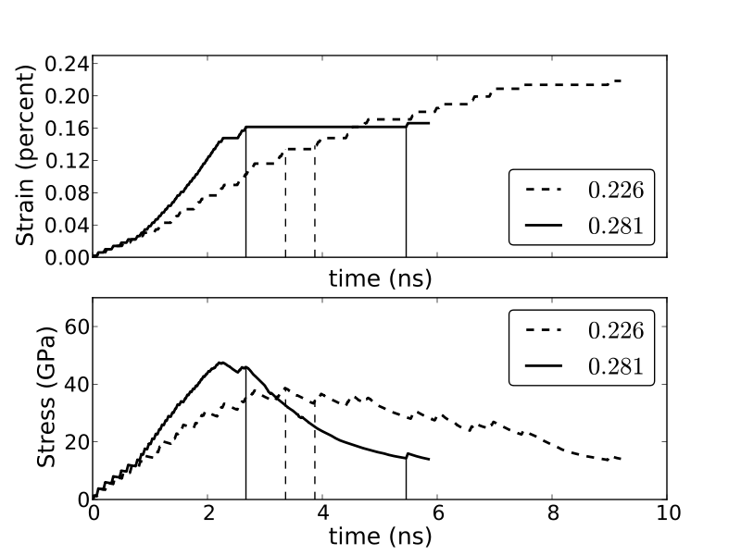
Time evolution of the stress and strain for a 4000-Å bundle.
The average length of the CNTs in the bundle is 1000 Å with a standard deviation of 200Å. The initial percentages of cross-links in the fibers are 0.226 and 0.281.
Recall that displacement boundary conditions were used in the simulations. While the average strain in the bundle was holding constant, inside the bundle, bonds were failing and the average internal stress was decreasing.
Failure in all fibers begins when bond breaking, defect formation, and slipping or failure of the CNTs occur in the fibers. This results in a release of stress and causes structural changes in the fiber. If the resulting structure of the fiber is able to support the residual stress, the stress stabilizes. Otherwise, the fiber will fail again and the process is repeated until the stress stabilizes or the fiber breaks.
Notes:
Contrast brittle and ductile behavior

Slide 18
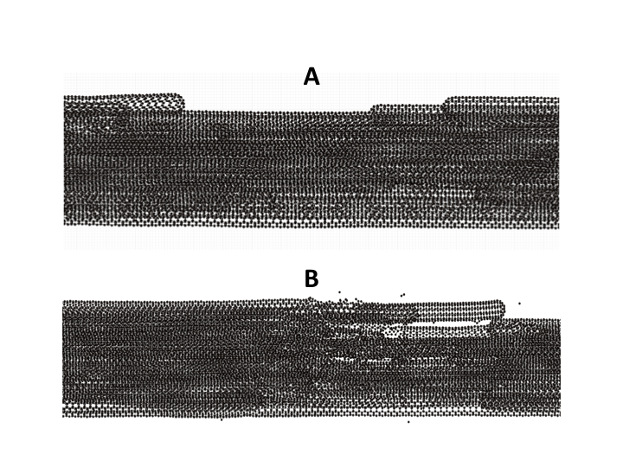
Figures shows the damaged section of the bundle (0.226) at the start of failure and after the stress stabilizes.
A: A maximum stress of 38.57 GPa at a strain of 0.134 in 3.36 ns.
B: The strain was held constant for 0.51 ns before the bundle stress stabilized at a stress of 34.67 GPa.
Notes:
Necking in fig A

Slide 19
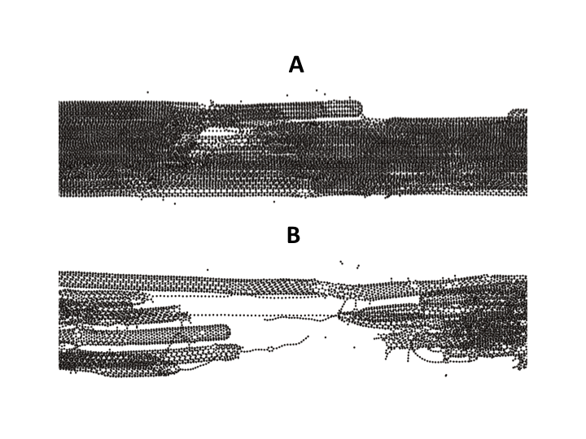
Figures shows the damaged section of the bundle (0.281) at the start of failure and after the stress stabilizes.
A: A maximum stress of 47.49 GPa at a strain of 0.143 in 2.20 ns.
B: At 2.67 ns and a strain of 0.162, the bundle began to fail. At that point, the average strain held constant and the stress decreased to 14.30 GPa before reaching equilibrium at 5.46 ns.

Slide 20
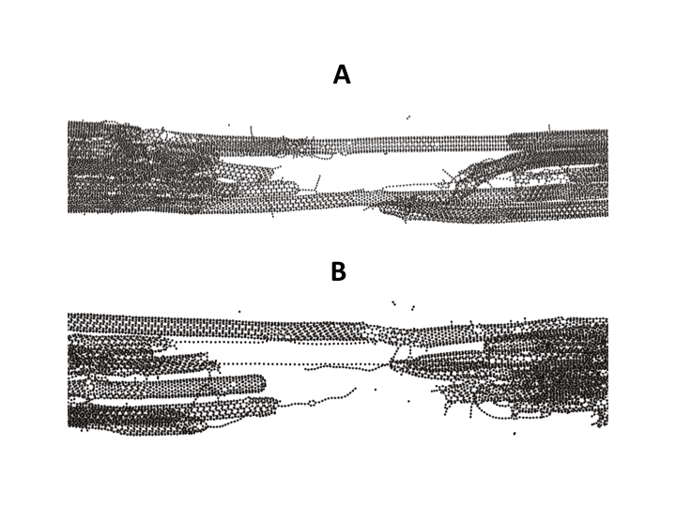
Figures shows the damaged section of both fibers
A: Strain of 0.218 (0.226) with ductile response
B: Strain of 0.162 (0.281) with brittle response
Notes:
Add slide with conclusions
Offers a method for controlling the brittle or ductile properties of CNT fibers

Slide 21
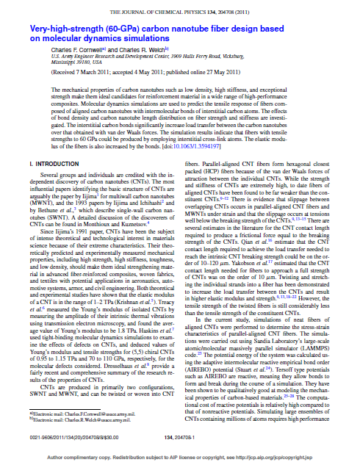
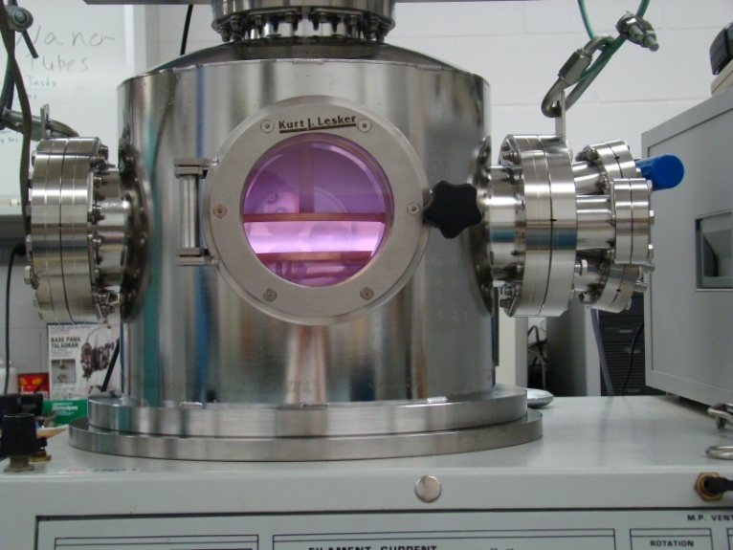
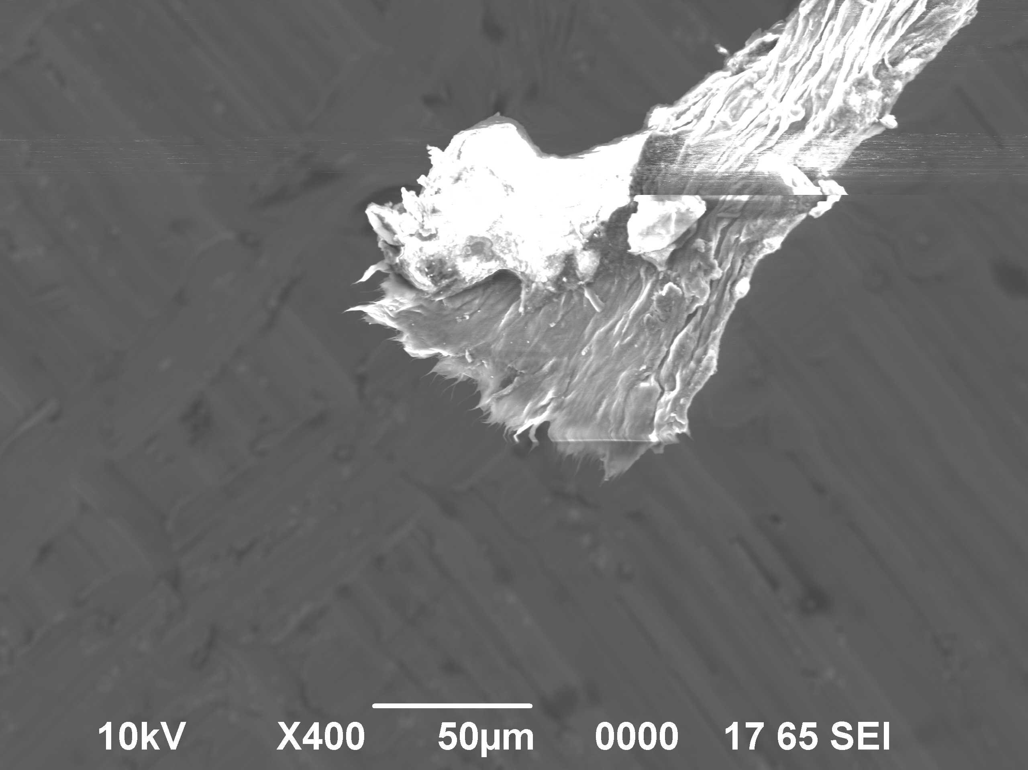

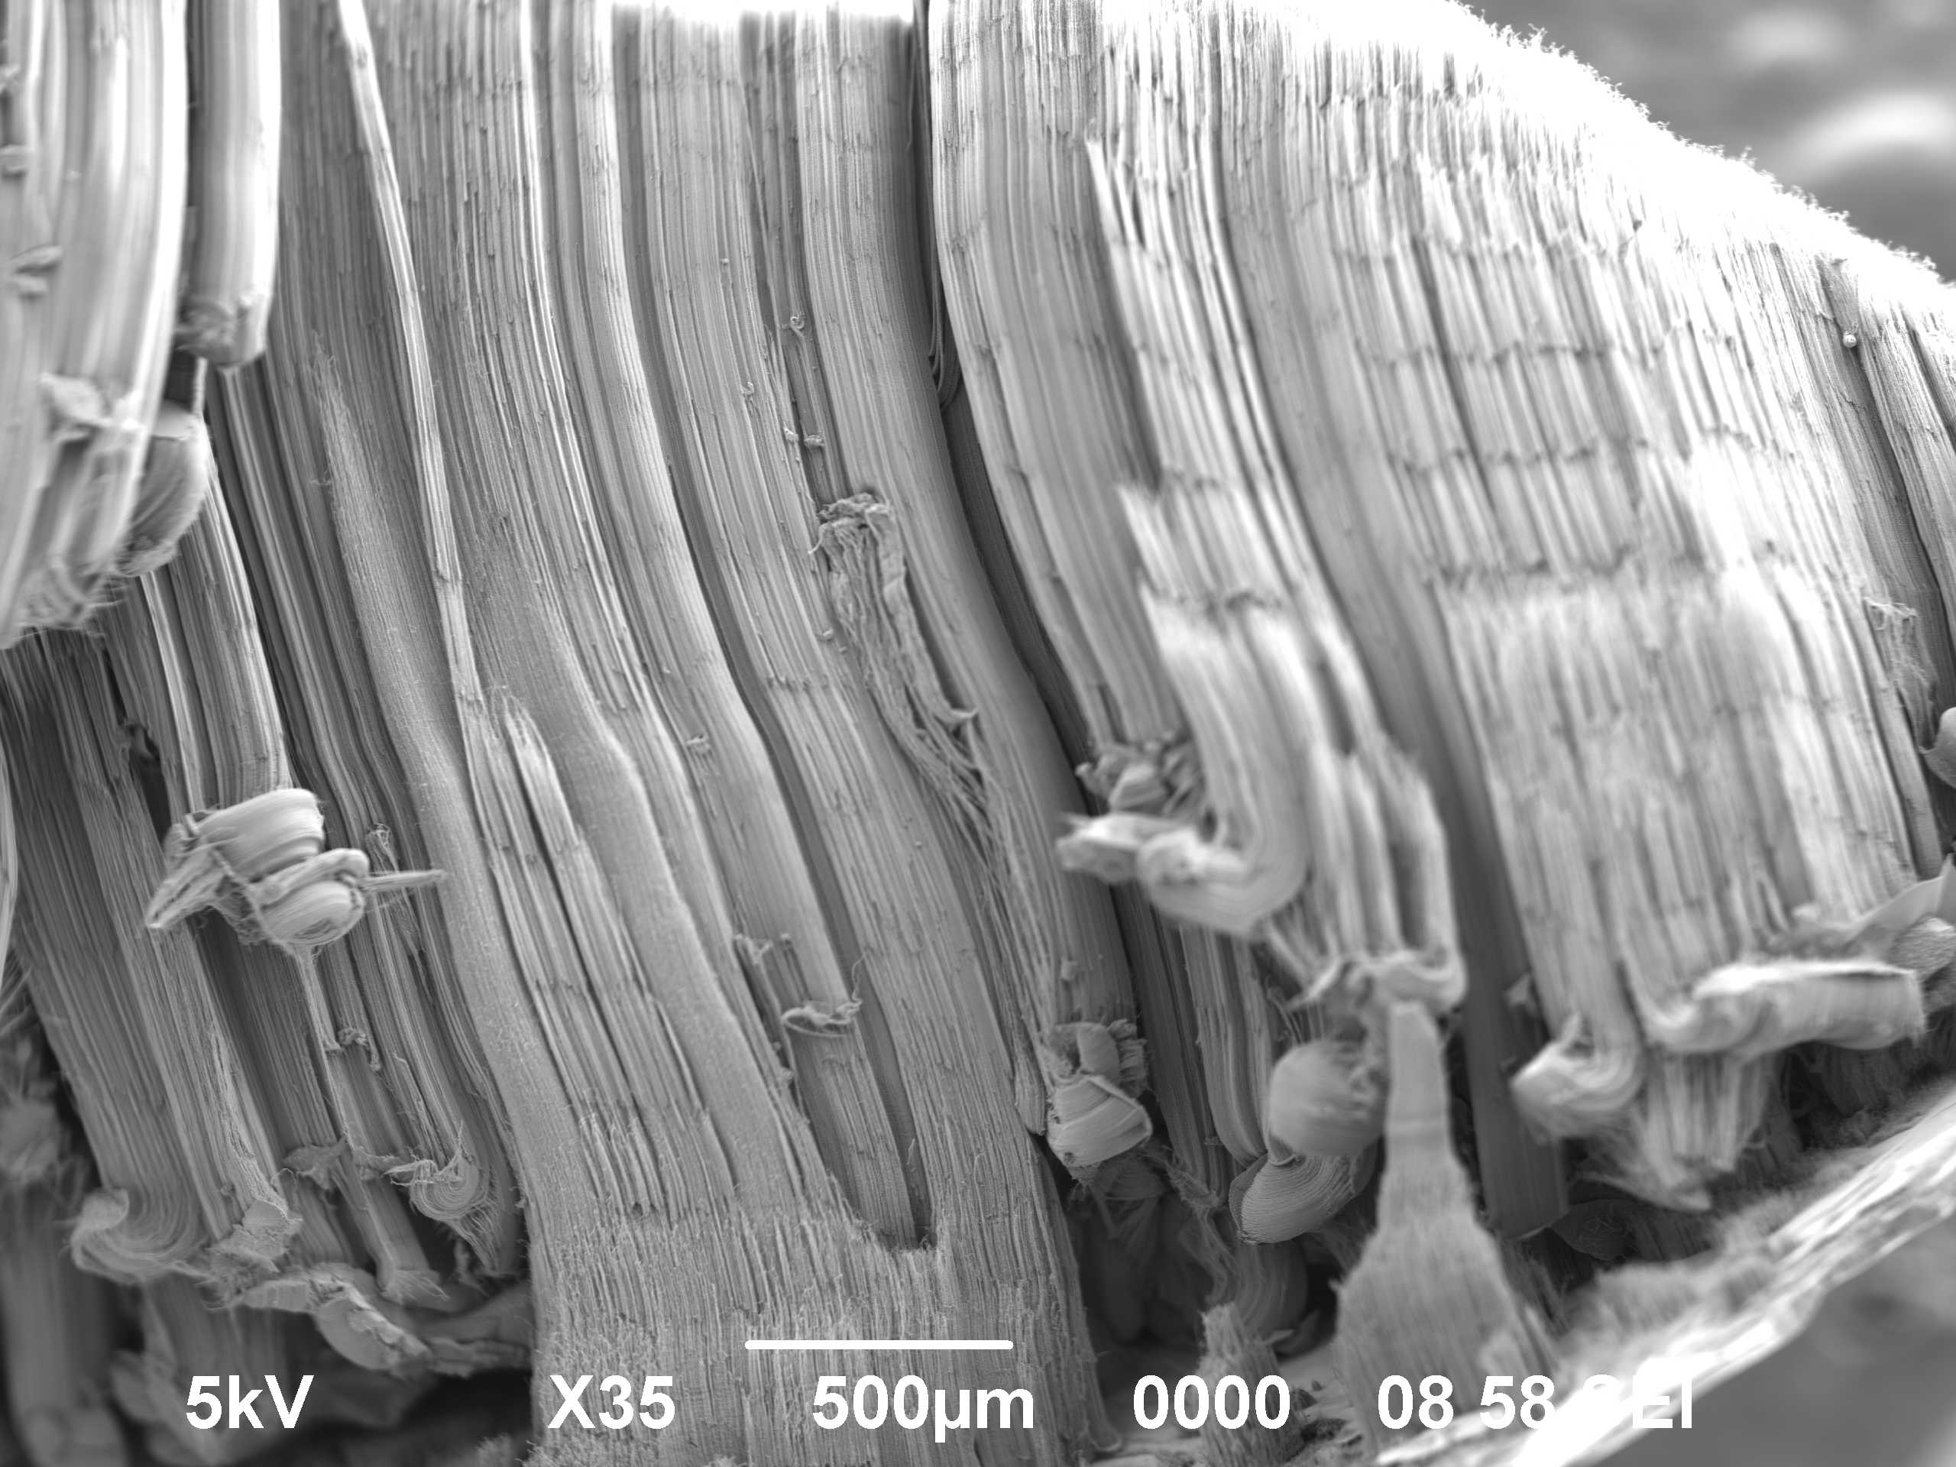
Building the CNT Fiber
Some ERDC Contributions - CNT Material Synthesis
Discovery of CNT Forest Growth Termination Mechanism
(with MIT/ISN)
Plasma Processing of CNT Fibers
~ 8.6 Million PSI
384,000 PSI CNT Fiber (with MIT/ISN)
CCVD Synthesis Refinements
(3.5-mm CNT Forests, possibly DoD Record)
Self-Assembled Tube Structure (SATS) Discovery
ERDC Cover Article
Marsh et al., Carbon, May 2011.
Notes:
Plasma Processing of CNT
Structures to Induce Cross-Bonding

Slide 22
ERDC Advanced Material Initiative
Super Ceramic

Slide 23
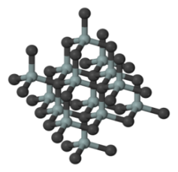
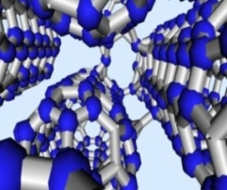
Super CNT/Graphene - Ceramic Composite
Bonded CNTs
(Cornwell, 2008)
Silicon carbide (Wikipedia)
Performance goals for CNT/graphene-ceramic composite are (5X tensile strength/toughness):
  Density of ~175 lbs/ft³ – same as aluminum.
  Min. Young’s modulus ~ 30 million psi – same as steel.
  Min. compressive/tensile strength ~ 300,000 psi.
  Min. fracture toughness – 25 MPa m^{1/2} - same as aluminum.
Given the above, the CNT/graphene-SiC composite would have:
  3X stiffness-to-weight ratio of aluminum or steel.
  4X strength-to-weight ratio of high-strength aluminum (e.g., 7075-T6).
  9X strength-to-weight ratio of high-strength steel.
CNT/graphene super ceramic would be made of carbon and silicon, abundant materials.
CNT/graphene-SiC could result in 2/3 weight reduction (or more) for Army steel and aluminum equipment for designs constrained by maximum deflection or maximum load.
Warning: not known to be impossible, but considered very challenging goals. One ceramic researcher response: “not in my lifetime.”
Notes:
Tensile strength and fracture toughness

Slide 24
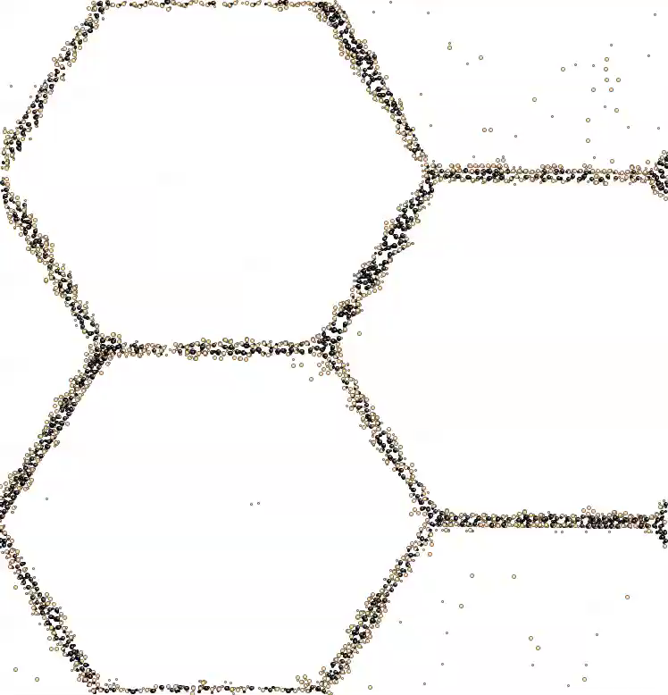

Preliminary Simulations of Fracture in Nano-Crystalline 4H-SiC
Columnar supercell of 20nm crystals viewed along the [1120] direction.
Crystals are variously rotated around the [1120] axis. Stress is applied in the (1000) plane.
Normal atoms are invisible for clarity.
Black atoms are under-coordinated at grain boundaries and surfaces.
Tan atoms are in a distorted crystal orientation (HCP instead of FCC).
Stress
(B. Devine, 2011)
6fps.wmv

Slide 25
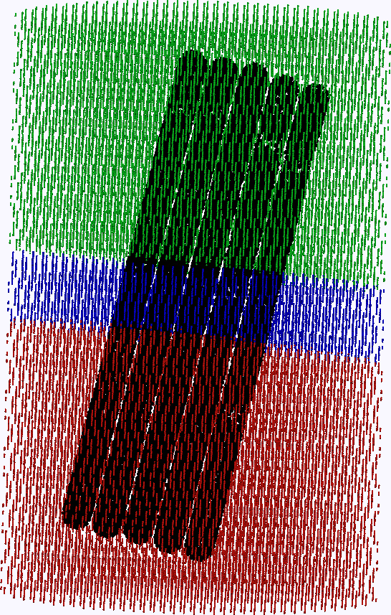
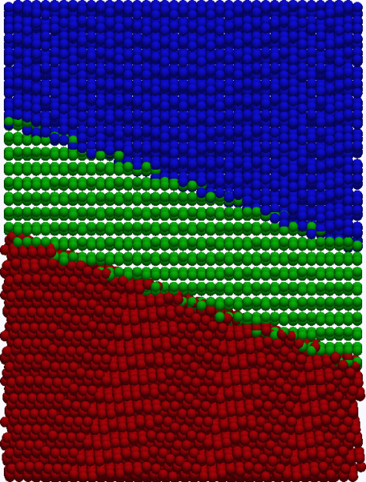
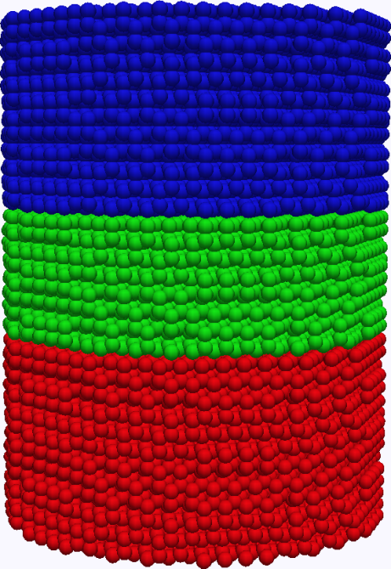
Building Molecular Dynamics (MD) Modeling Capabilities
Grain Boundary Simulations
Prescribed parameters in MD model build:
Crystallographic orientation of the grain
Grain boundary thickness
Grain boundary composition
Grain boundary orientation (azimuthal & polar)
Fiber length and orientation (azimuthal & polar)
Fiber crosslink concentration (CNT-CNT & CNT-matrix)
Fiber average CNT length and standard deviation

Slide 26
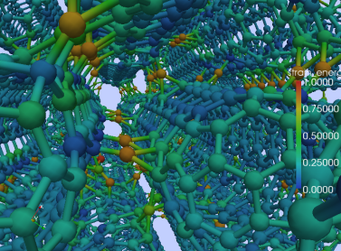
Summary
The material development paradigm is changing (design first; then build):
  Atomistic/multiscale simulations used to guide material design.
  Exotic molecules/crystals, e.g., carbon nanotubes, silicon carbide.
  Evolving nanoscale diagnostics and experiments to validate simulations.
  Evolving synthesis methods.
ERDC, and others, are making rapid progress toward a 1-million-PSI (plus) CNT-based tensile material (lab demo).
ERDC is using these technologies to develop a lab demo of a ceramic composite to replace aluminum and steel with 2/3 weight reduction.
Nanotechnology is the big frontier for engineering technology advancement for the next several decades.
Other countries are taking similar approaches to material development with most of the literature being published within the 4 years.
Revolutionary improvements in materials are occurring.

Slide 27
ACKNOWLEDGMENTS
This study gratefully acknowledges funding support from the U.S. Army Engineer Research and Development Center Directed Research Program "Nanoscale Studies of Polycrystalline Materials with Emphasis on Ceramic Synthesis" and the HPC Challenge Project "Molecular Dynamics Simulations To Underpin the Design and Development of High-Performance Carbon-Nanotube-Based Filaments, Membranes, and Coatings" and allocation of computer time from the Department of Defense High Performance Computing Modernization Program. Permission was granted by the Chief of Engineers to publish this information.

