Slide 1
Atomic scale investigation of grain boundary structure role on deformation and crack growth dynamics in Aluminum
I. Adlakha¹, K.N. Solanki¹, M.A. Tschopp²
¹School for Engineering of Matter, Transport, and Energy
Arizona State University
www.multiphysics.lab.asu.edu kiran.solanki@asu.edu
²Army Research Laboratory, Weapons and Materials Research Directorate, APG, MD 21014.
We acknowledge the support of the Office of Naval Research under grant N000141110793

Slide 2
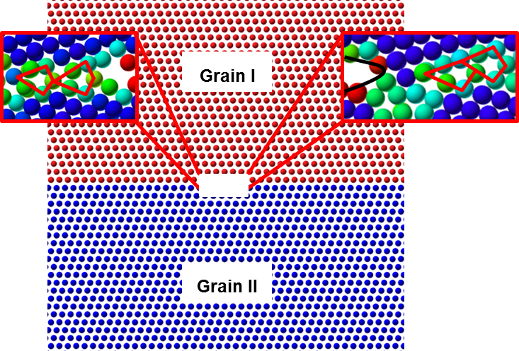
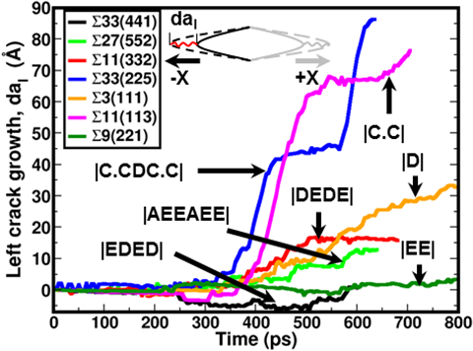
Motivation
The role of GB characteristics mentioned below on intergranular fracture
Structural units (SUs)
GB energy
Initial free volume
The slip plane orientation relative to the crack plane and the growth direction.
The slip plane angle relative to the crack plane and the growth direction sufficient to describe the directional crack growth behavior and the ductile/brittle response.

Slide 3
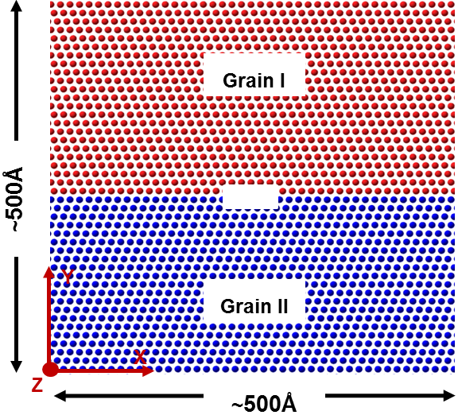
Methodology
Molecular Dynamics (MD) simulations were carried out using LAMMPS.
Liu et al.’s semi empirical embedded atom method (EAM) was used for the modeling atomic behavior of Al.
Initially a GB specimen of dimensions 500Å x 500Å x 40Å.
Non-periodic boundary (s) along the X and periodic boundary (p) conditions in the Y and Z.
Energy minimization (NVE) was carried out for 120fs, followed by a pressure relaxation (NPT) for 80fs at 300K.
Initial crack of 2a/W = 0.1 is created in the middle of domain.
Strain rate 10⁸ 1/s is applied along the Y direction, while performing NVT minimization.
The red and blue regions are grains I and II, respectively. The z-axis for both the grains is same i.e. <100> or <110>.
Notes:
Aluminum Symmetric tilt grain boundaries were fractured under uniaxial tension at 300K using LAMMPS.

Slide 4
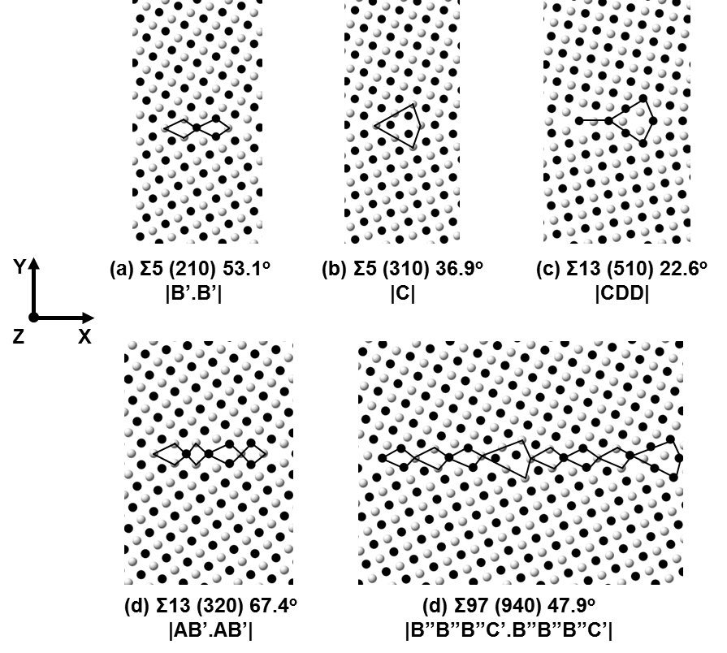
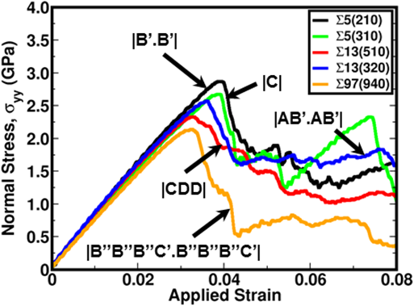
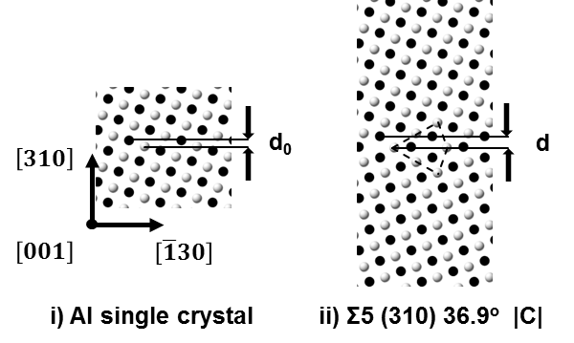
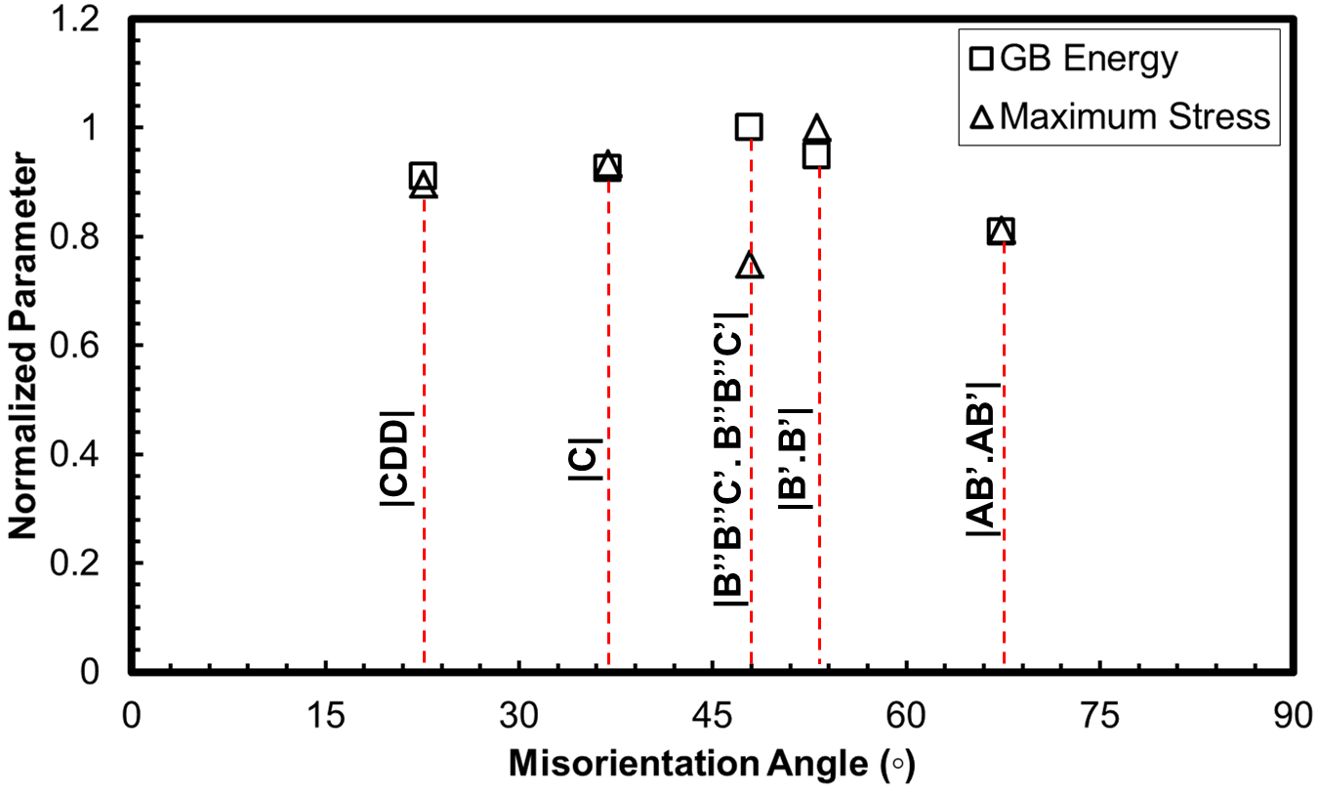
Overview of <100> STGBs
A schematic of GB (Δz* = d - d₀) free volume measurement
The maximum stress for GBs with ‘D’ or SF present, such as Σ13 (510) θ=22.6° and Σ97 (940) was lowest.
Σ97 (940) has 25% drop in maximum stress when compared to the Σ5 (210)
The GB energy correlates to maximum stress of GBs, except for Σ97 (940) which has highest GB energy.
Notes:
The <100> GB are described here with help of SUM (Vitek, Sutton). A,B’,C and D were part of favored GBs along <100>.D SU connecting different {100} and {200} atoms. Initial free volume for the GB interface were estimated by finding the interplanar distance of GB plane in pristine condition vs interplanar distance in the vicinity of GB. This change in interplanar distance was correlated to accommodate the GB interface. Sig 97 has highest initial free volume and highest GB energy among the <100> GBs evaluated.

Slide 5
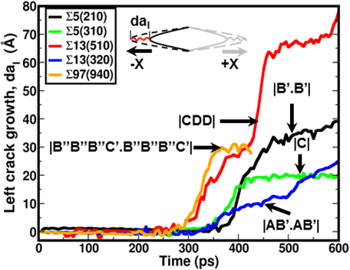
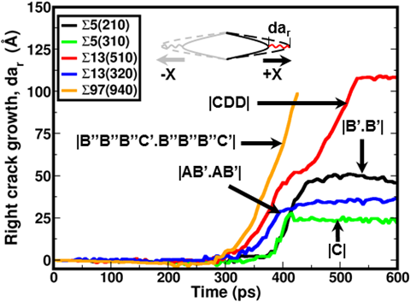
Crack growth for <100> STGBs
Growth along the Σ13 (510) differed on each sides, as evidenced by 100 m/s (425 - 460 ps) along the –X direction and 55 m/s (450 - 540 ps).
Σ97 (940) has maximum crack growth rate of 45 m/s and 75 m/s along the –X and +X directions.
The interfaces with a higher initial free volume witnessed higher crack growth rates compared to other GBs.
Notes:
The initial crack growth was negligible due to still being within critical energy release rate required to cause irreversible damage. Crack grew in between dislocation activities ahead of the crack tip. The relative plateau in growth is primarily due to nucleation of a dislocation and its movement through the grain.
Crack growth along +X and –X direction for Σ5 (210), Σ5 (310) and Σ13 (320) show relatively small asymmetry. The Σ13 (510) and Σ97 (940) displayed greatest asymmetry on directional crack growth along each GB.

Slide 6
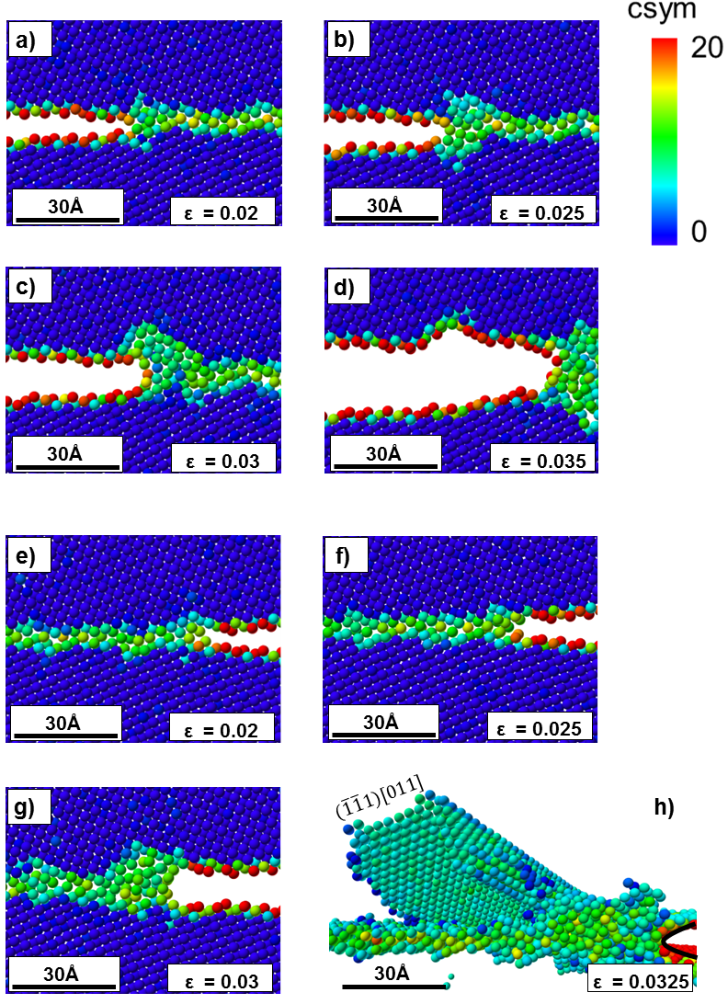
Crack Growth Asymmetry in Σ97 (940)
The interface ahead of the crack tip underwent localized atomic shuffling.
The crack along the +X direction fails to nucleate a slip dislocation and grows in a brittle manner, in contrast the –X direction observes a slip nucleation around 3.25 % applied strain.
These events have been identified as the primary cause for the directional crack growth response observed.
Notes:
Crack growth along +X direction showed absence of dislocation activity ahead of crack tip. Plastic events ahead of –X direction witnessed dislocation nucleation at 3.25%.

Slide 7
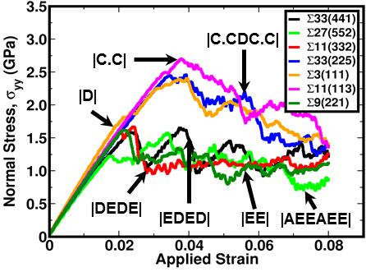
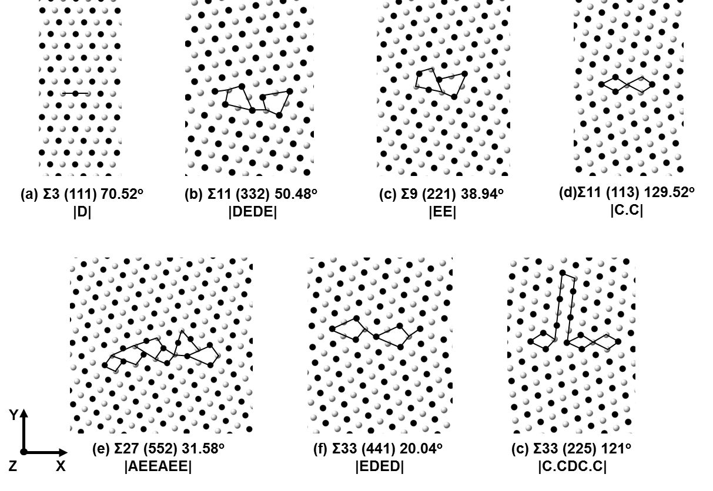
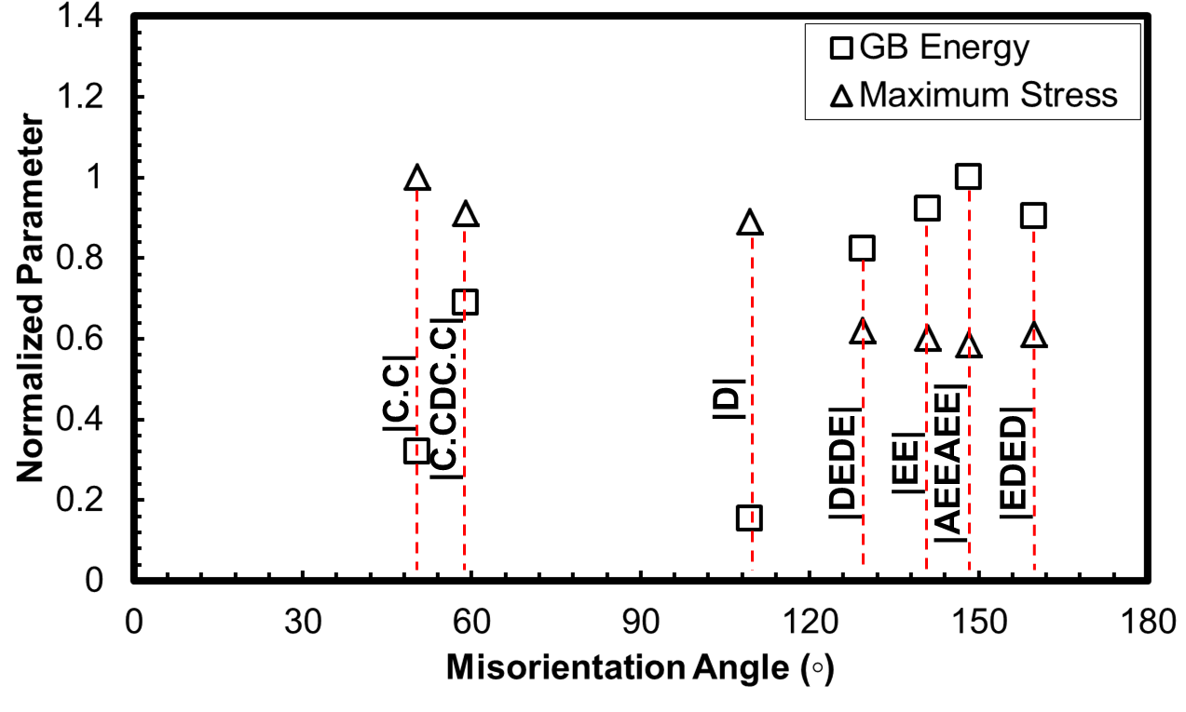
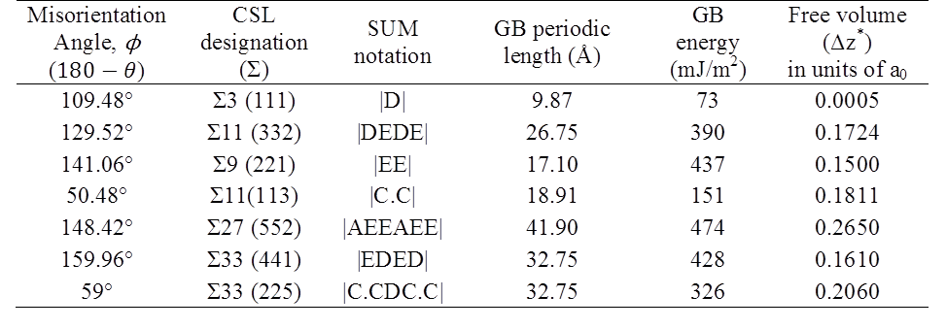
Overview of <110> STGBs
White and black denote atoms on different {110} and {220} planes.
D is a SU that typically terminates SF at the GB plane. In the case of Σ3 (111), the {111} are inclined at 39º forming a coherent twin interface.
E SU is a kite shaped SU consisting of 4 atoms in the description. It plays a important role in the fracture behavior of the interface.
Two distinct sets, i.e., one for GBs with a structural period containing ‘E’ SU and another one for GBs without ‘E’ SU .
Presence of ‘E’ SU lowers the dislocation nucleation stress ahead of the crack tip, thus lowering the maximum strength of the GB interface.
Notes:
Theta for <110> represents the boundary angle, misorientation angle could be easily found by 180-theta. The presence of ‘E’ SU brings a larger initial free volume available at the interface.

Slide 8
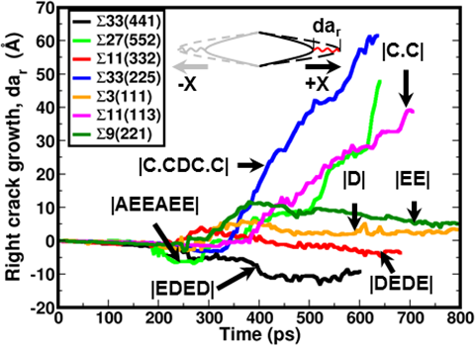
Crack growth for <110> STGBs
Along most of the <110> GB interfaces, the crack growth was found to negligible with increased applied strain, with the exception to Σ27(552),Σ11(113) and Σ33(225) STGBs.
The Σ27(552) has substantial crack length on the right side (50$Å$), as compared to the left which has negligible maximum crack length (1$5Å$).
The growth rates were found to be correlated to the initial free volume.
Notes:
All the ‘E’ SU GBs displayed twin nucleation ahead of the crack tip along both the direction and due to growth of twin causes negligible or small crack growth. Recess in growth activity as previously mentioned were due to dislocation nucleation and their motion. The growth rates are in correlation to initial free volume of the interface.

Slide 9
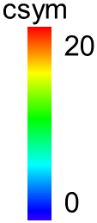
Crack Growth Asymmetry in Σ11(113)
The incipient strain of the plastic event along each crack tips varied greatly. At the applied strain of 2.6%, an ISF was nucleated ahead of the crack tip along the +X direction; subsequently, a partial dislocation ($\overline{1}\overline{1}1)\left[\overline{1}\overline{1}\overline{2}\right]$ was nucleated from the ISF.
The amount of atomic movement ahead of the crack can be seen as negligible to accommodate plastic deformation.

Slide 10
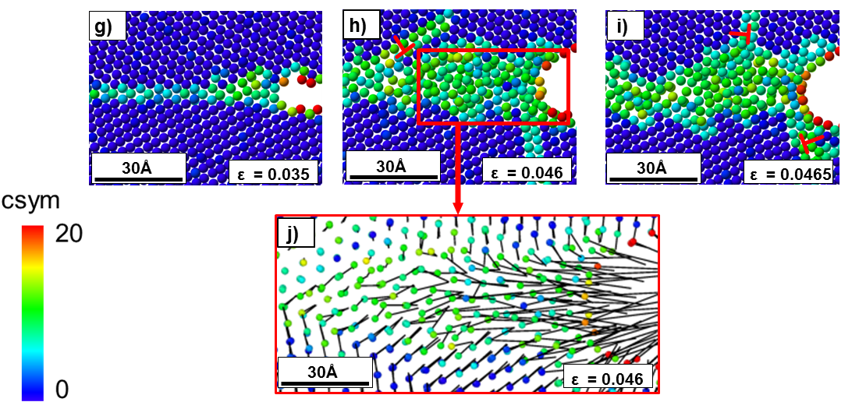
Crack Growth Asymmetry contd.
Along the –X direction, a steady state crack growth was observed up to an applied strain of 3.5% .subsequently followed by nucleation of an ISF.
The growth along the –X direction between applied strains of 3.5-4.6% was retarded, primarily due to blunting of the crack tip and due to the high relative angle between the initial slip system and the crack plane (121.48⁰) requiring a large amount of energy to propagate the dislocation .

Slide 11
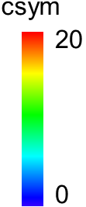
Twin Deformation in <110> STGB
Rearrangement of ‘E’ SU creates an ISF; which acts as a site for a partial dislocation .
The leading partial was trailed by a twin partial dislocation to form the twin embryo.
An interesting feature of plastic events was limited atomic movements for twin deformation.

Slide 12
Conclusion
The normal interface strength for GBs containing ‘D’ SU or SF in the GB structural description (Σ13 (510) θ=22.6° and Σ97 (940) θ=47.9°) showed noticeably lower interface strength compared to other <100> GBs.
The stress-strain response for the <110> STGB interface shows presence of two distinct regimes the ‘E’ SU GBs (ϕ > 109.47°) and the remaining GBs (ϕ < 109.47°).
Presence of ‘E’ SU lowers the maximum normal interface strength by an average 35% when compared to other <110> STGBs.
The maximum growth rate witnessed by the GB interface was in correlation with the initial free volume of the GB interface,
The orientation of slip planes relative to the crack plane and the growth direction were found to be a key aspect to inception of directional crack growth response.

Slide 13
Thank You

