Slide 1
Force-controlled walls and their application for shear tester simulations
LAMMPS workshop on August 8, 2013
Andreas Aigner
<andreas.aigner@jku.at>
CD Laboratory on Particulate Flow Modelling
Johannes Kepler University | Linz | Austria

Slide 2
Outline
Material properties
Jenike shear tester
Basic idea
Experimental set-up
Numerical model
What LIGGGHTS already can…
Force controller
Comparison of experimental and numerical results
Conclusions

Slide 3
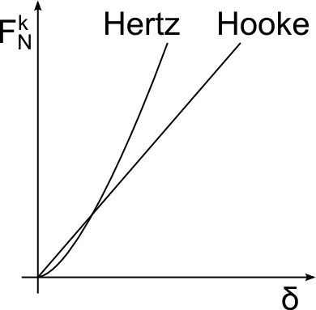
Material properties
Commonly used DEM contact models are spring-dashpot
Material properties for Hertz model
Radius [R]
Mass [m]
Young‘s modulus [E]
Poisson‘s ratio [ν]
Coefficient of restitution
Coefficient of friction [μ_{r}]
$$k_{n,Hooke}=\frac{16}{15}\sqrt{R_{eq}}E_{eq}{\left(\frac{15 m_{eq}V^{2}}{16\sqrt{R_{eq}}E_{eq}}\right)}^{\frac{1}{5}} \\ k_{n,Hertz}= \frac{4}{3}E_{eq}\sqrt{R_{eq}δ_{n}}$$
$$F_{T}≤μ_{r}F_{N}$$

Slide 4
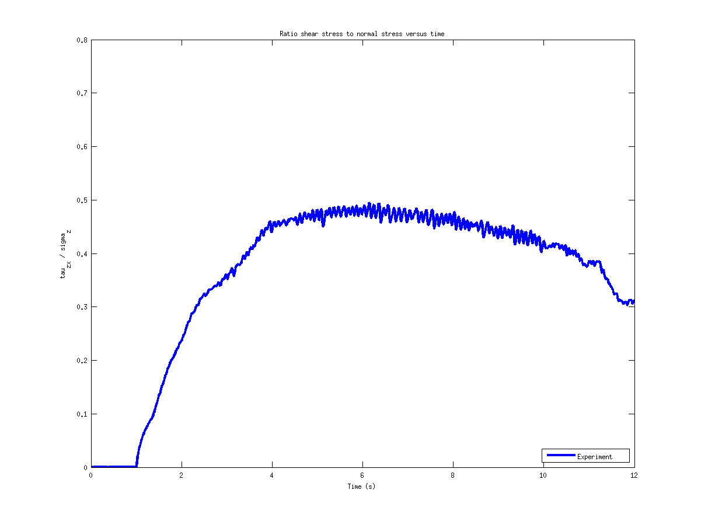
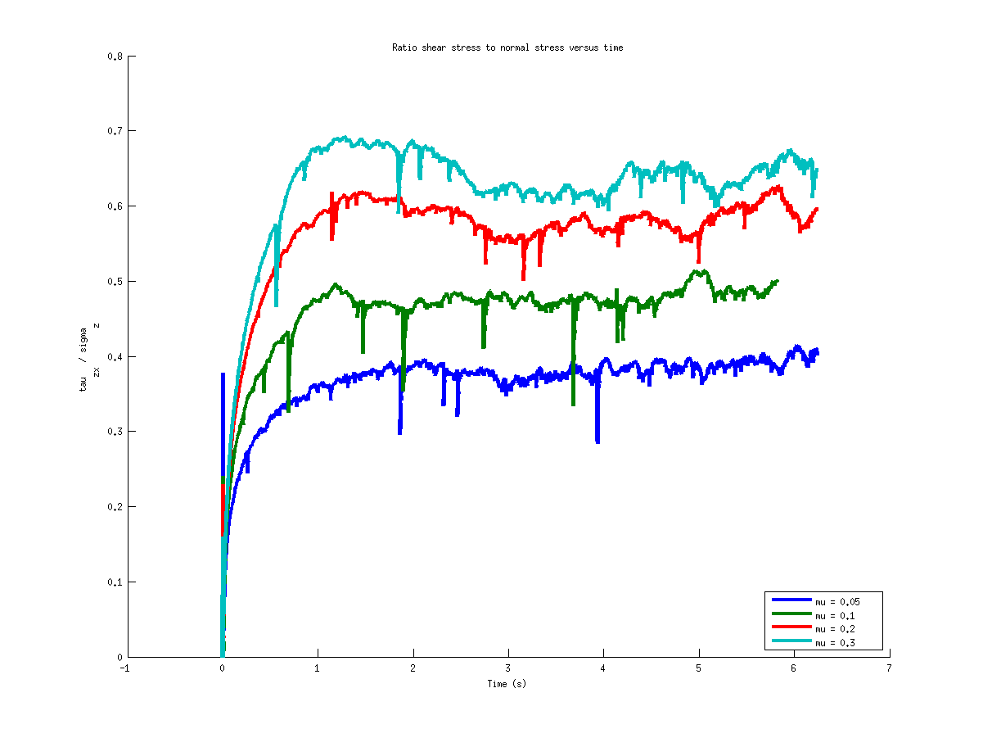
Method
Determination of the coefficient of friction by means of a comparison of experimental and simulation results of a simplified Jenike shear tester
Average of several experimental runs
Numerical results for varying coefficient of friction
Compare of the ‚steady-state‘ flow
τ_{xz}/σ_{z}
τ_{xz}/σ_{z}
Time (s)
Time (s)

Slide 5
Jenike shear tester
Shear cell of the Jenike shear tester
(from Schulze D., Flow Properties of Powders and Bulk Solids, 2011)

Slide 6
Experimental set-up
Requirements for the numerical simulation:
Motion of one ring with constant velocity
Determination of the force acting on the rings
A constant normal force has to be applied to the particles
Scatch of the simlified Jenike shear tester used for experiments.

Slide 7
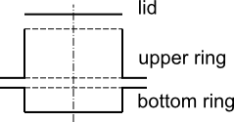
Numerical simulation
The shear cell consists of a lid and two rings
Therefore triangulated meshes are imported

Slide 8
What LIGGGHTS already can..
A triangulated mesh can be moved and rotated with variable or constant velocity and angular velocity, respectively.
All forces and torques acting on one geometry are calculated and accessible in the input script
fix cad1 all mesh/surface/stress file mesh/upperCyl.stl type 2 scale 0.001 move 0. 0. 0. com 0. 0. 0.
variable FxCad1 equal f_cad1[1] variable FyCad1 equal f_cad1[2]
…

Slide 9
Force controller
PID-controller
with anti-windup mechanism
maximum velocity limiter
$$v_{wall}\left(n\right)=k_{p}e\left(n\right)+k_{i}\sum_{k=0}^{n}{e\left(k\right)+k_{d}\left(f_{total}\left(n\right)−f_{total}\left(n−1\right)\right)}$$
This approach can also be used to control the torque by replacing force and velocity by torque and angular velocity.

Slide 10
Numerical set-up

Slide 11
Check the servo-wall
Normal stress applied by the servo-wall
These results are achieved with a pure proportional controller:
The normal stress is kept constant
Only a small overshoot at the first particle-wall contact
σ_{z} (Pa)
Time (s)

Slide 12
Results
Example for glass beads with r = 0.25 mm
Ratio shear stress / normal stress versus time
Time (s)
Time (s)

Slide 13
Conclusions
A force controlled ‘servo-wall’ was implemented into the framework of LIGGGHTS
This new wall type provides a constant normal stress for the simulation of a simplified Jenike shear tester.
By comparing experimental and numerical results the coefficient of friction is determined for individual granular material.

Slide 14
Thank you. Questions?
Johannes Kepler University Linz
CD Laboratory on Particlulate Flow Modelling
Contact:
andreas.aigner@jku.at

